Slide 1
College of Behavioral & Community Sciences
Fall 2020 Faculty & Staff Assembly
October 16, 2020

Slide 2
Agenda
Welcome
Introducing New Faculty and Staff
USF Faculty Senate Updates
Faculty Council Report
Tenure & Promotions Announced
Curriculum Committee Report
Diversity & Inclusion Report
Research Council Report
Dean’s Report and Q&A
Faculty Research Presentation
8. Open Discussion

Slide 3
Welcome New CBCS Faculty and Staff

Slide 4
New CBCS Faculty
Beth Boone, Ph.D
Executive Director, CARD/LTA
Research Assistant Professor, CFS
Donna Ginns, Ph.D, BCBA-D, LP
Instructor, CFS
Elisabel Chang, MS, CCC-SLP,
TSSLD-BE
Visiting Clinical Instructor, CSD
Thomas Hyslip, Sc.D.
Instructor, CCJ
Donna Flanders, MS, CI & CT
Visiting Instructor, CSD
Natalie Mikkelson, MA, CCC-SLP
Visiting Clinical Instructor, CSD

Slide 5
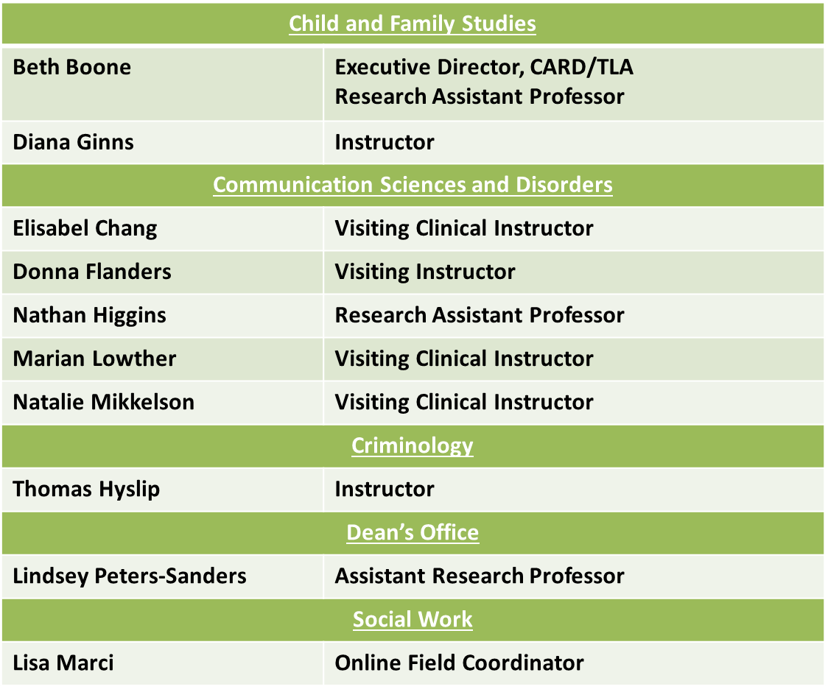
New CBCS Faculty

Slide 6
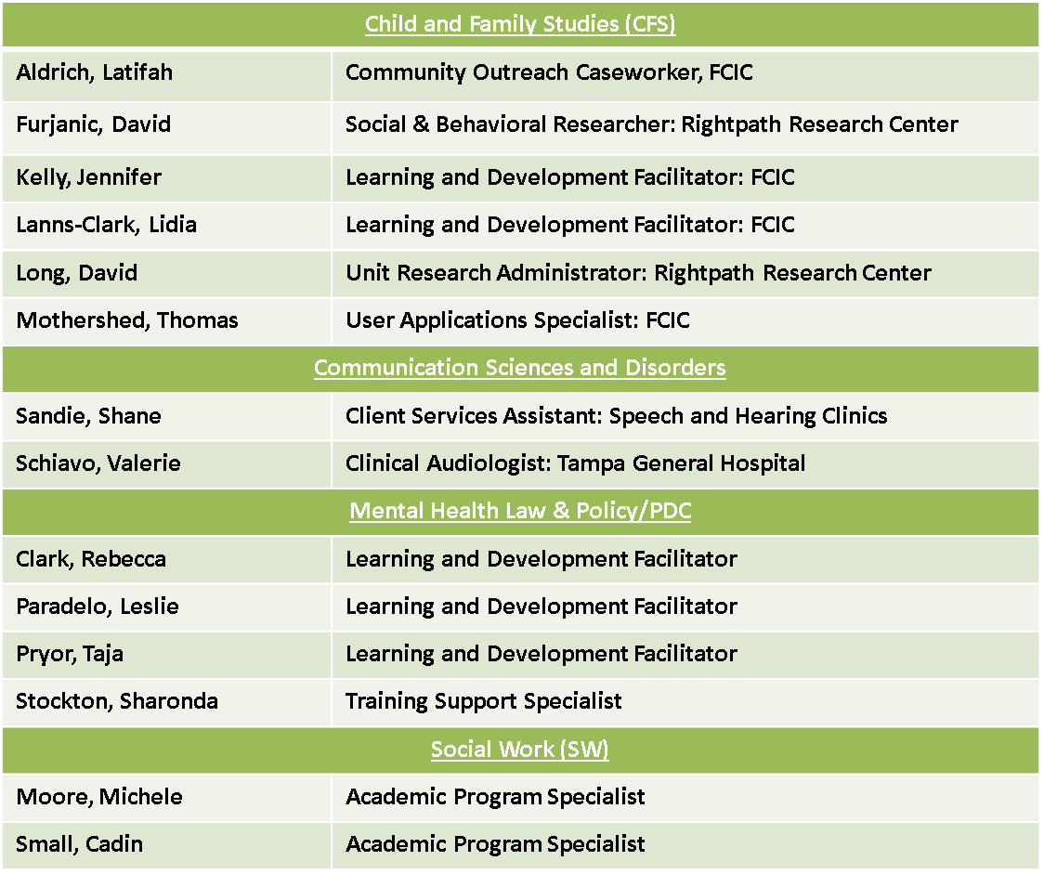
New CBCS Staff

Slide 7
USF Faculty Senate Updates Tim Boaz, President

Slide 8
Faculty Senate Overview & Updates
The Faculty Senate is the primary faculty advisory body to the USF President, Provost, and Vice President for Health on all matters that pertain to the academic climate of the university.
President: Timothy Boaz (CBCS, MHLP ) MHC2736, Ext. 4-1933; E-mail: boaz@usf.edu

Slide 9
Faculty Senators from CBCS
Tina Dillahunt-Aspillaga – CFS (2021-23)
Jenna Luque – CSD (2019-21)
Ann Eddins – CSD (2019-21)
Fawn Ngo – CRIM (2019-21)
Timothy Boaz – MHLP (2019-21)
Brent Small – SAS (2019-21)
Nan Sook Park – SSW (2019-21)

Slide 10
USF Faculty Senate Council Representatives from CBCS
Graduate Council
Amy Davis - CSD (2018-22)
Ray Miltenberger, Chair – CFS (2018-22)
Educational Policy & Issues
Elizabeth Cass – CRIM (2019-22)
Undergraduate Council
TBD
Publications Council
Matthew Foster – CFS (2018-22)

Slide 11
USF Faculty Senate Council Representatives from CBCS
Faculty Issues
Jenna Luque - CSD (2021-23)
Student Admissions
Steve Surrency – CSD (2017-21)
General Education
William Haley – SAS (2018-22)
Samantha Thomas – CSD (2018-22)

Slide 12
USF Faculty Senate Council Representatives from CBCS
Technology in Instruction & Research
Timothy Boaz – MHLP (2018-22)
Honors & Awards
Victor Molinari - SAS (2019-23)
Research Council
Marilyn Stern – CFS (2019-23)
Library Council
Amy Vargo – CFS (2017-21)

Slide 13
Faculty Senate – Current Issues
Consolidation
Began functioning as consolidated Faculty Senate July 1, 2020
Establishing branch campus Faculty Councils
Updating Charges & Membership of existing Councils
Racial Justice
Resolution to USF administration
Forming a Council on Racial Justice
COVID/Budget Issues
Participated in developing plans for Fall and Spring semester
Meeting with administration on budget planning

Slide 14
Faculty Council Updates Daniel Meng, Chair

Slide 15
2020-21 Faculty Council Members
Full Member | Alternate Member | Department
Richard Moule, Jr. | Mateus Santos | Criminology
Devon Weist, Vice Chair | Kathy Carbonell | Communication Sciences & Disorders
Kwang-Sun Blair | Marilyn Stern | Child & Family Studies
Daniel Meng, Chair | Victor Molinari | School of Aging Studies
Iraida Carrion | Jerome Galea | School of Social Work
Tim Boaz | Kathy Moore | Mental Health Law & Policy

Slide 16
Faculty Council - Governance
The CBCS Faculty Council is responsible for ensuring that the Faculty’s role in the shared governance process of CBCS is consistent with the USF Faculty Senate principles of shared governance.
Faculty members have the principal responsibility for originating policy in the following areas: Academic & Scholastic Policies, Academic Ethics, and Research
Faculty members collaborate with the administration to make recommendations in the following areas: Policies and Procedures for Appointments, T&P Review, Discipline & Termination, Student Conduct & Activities, Budgetary Review & strategic planning, and Review/Selection of Academic Administrators
CBCS Governance Document- CBCS Intranet https://intra.cbcs.usf.edu/FacultyGovernance/

Slide 17
Faculty Council Planned Activities
Deans Awards Spring 2021
Continue to support CBCS Committees
Curriculum
Diversity and Inclusion
Tenure & Promotion
Attend to Faculty Concerns

Slide 18
Faculty Council Activities/Updates
Deans Awards Spring 2021
Continue to support CBCS Committees
Diversity and Inclusion
Curriculum
Tenure & Promotion
Attend to Faculty Concerns

Slide 19
Tenure and Promotions Jennifer Lister, Associate Dean

Slide 20
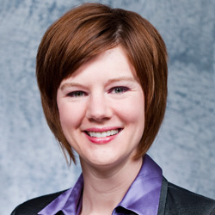
Amber Gum, Mental Health Law & Policy Promoted to Professor

Slide 21
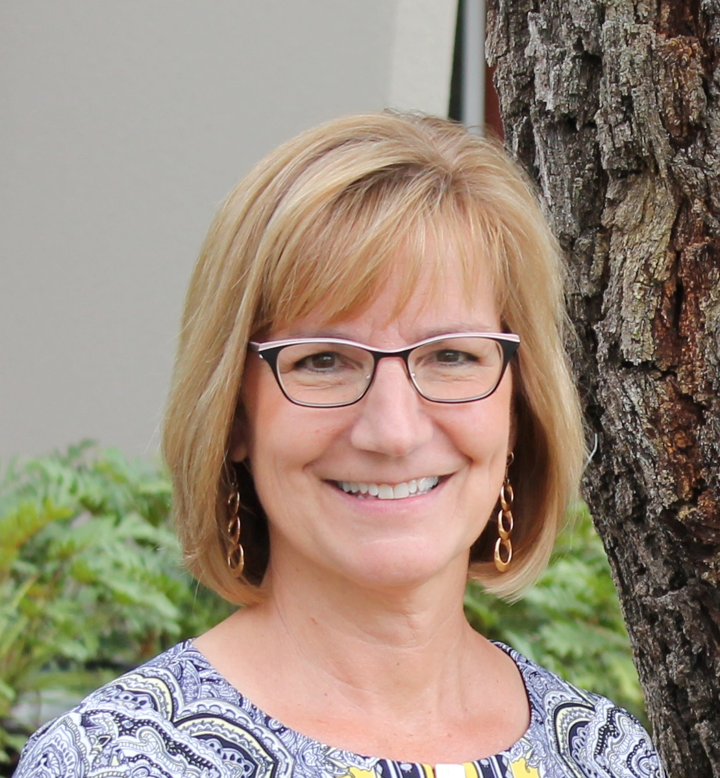
Ann Eddins, Communication Sciences & Disorders
Promoted to Professor

Slide 22
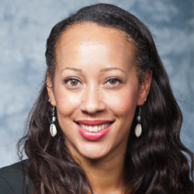
Kyaien Conner, Mental Health Law & Policy
Received Tenure and Promoted to Associate Professor

Slide 23
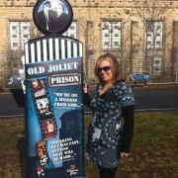
Dawn Cecil, Criminology, St. Petersburg campus
Promoted to Professor

Slide 24
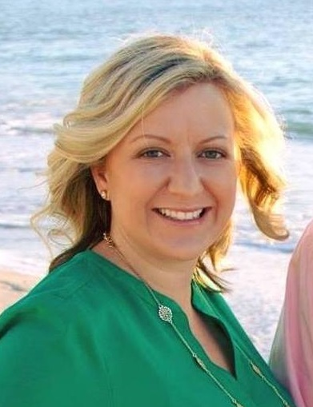
Jessica Grosholz, Criminology Sarasota-Manatee campus Received Tenure and Promoted to Associate Professor

Slide 25
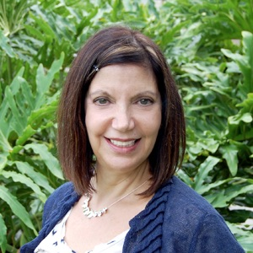
Rose Iovannone, Child & Family Studies Promoted to Research Associate Professor

Slide 26
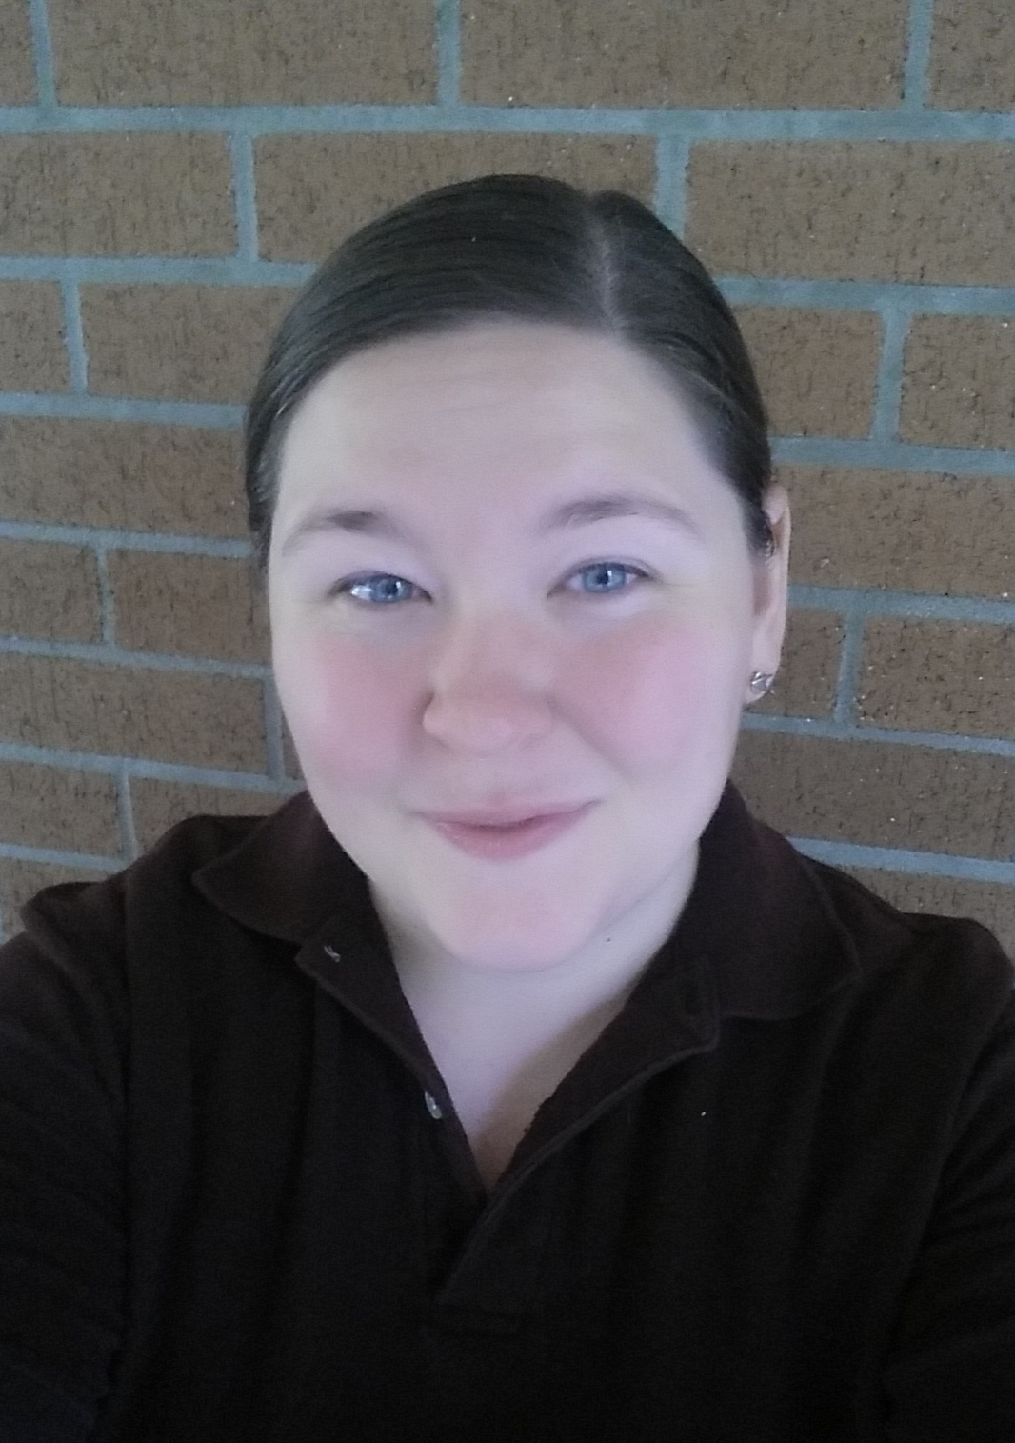
Samantha Thomas, Communication Sciences & Disorders
Promoted to Instructor II

Slide 27
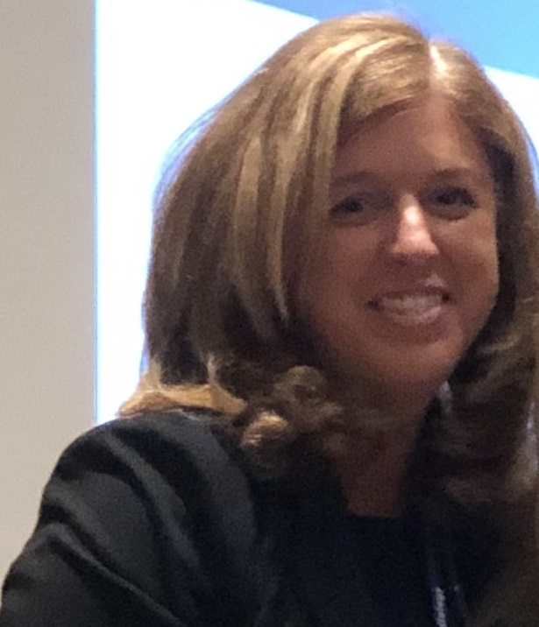
Devon Weist, Communication Sciences & Disorders
Promoted to Instructor II

Slide 28
Cheryl Paul, Communication Sciences & Disorders
Promoted to Instructor II

Slide 29
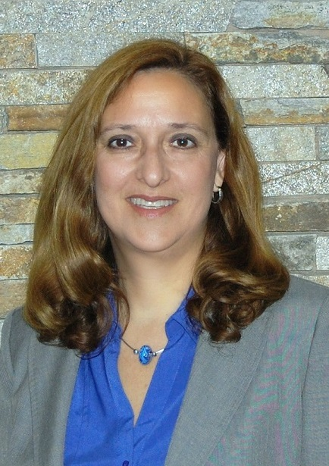
Elizabeth Cass, Criminology
Promoted to Instructor II

Slide 30
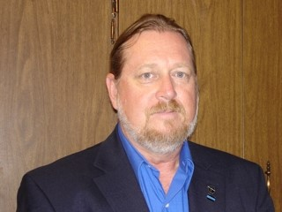
Robert LeGrande Gardner, Criminology
Promoted to Instructor II

Slide 31
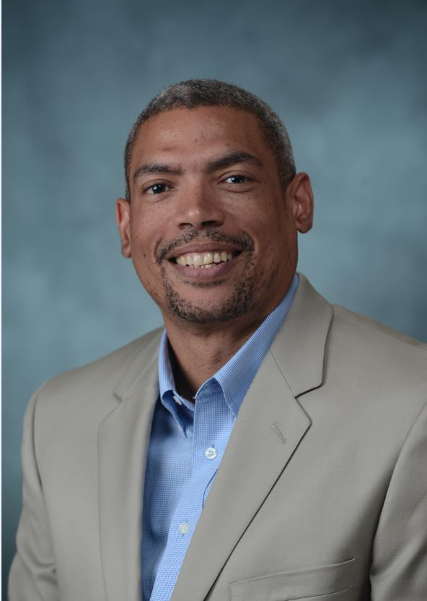
Chris Simmons, School of Social Work
Promoted to Instructor II

Slide 32
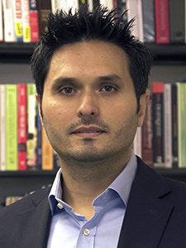
Murat Haner, Criminology Sarasota-Manatee campus
Promoted to Instructor II

Slide 33
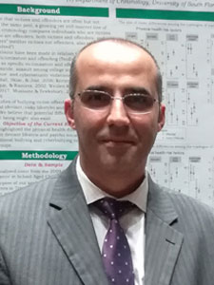
Rustu Deryol, Criminology Sarasota-Manatee campus
Promoted to Instructor II

Slide 34
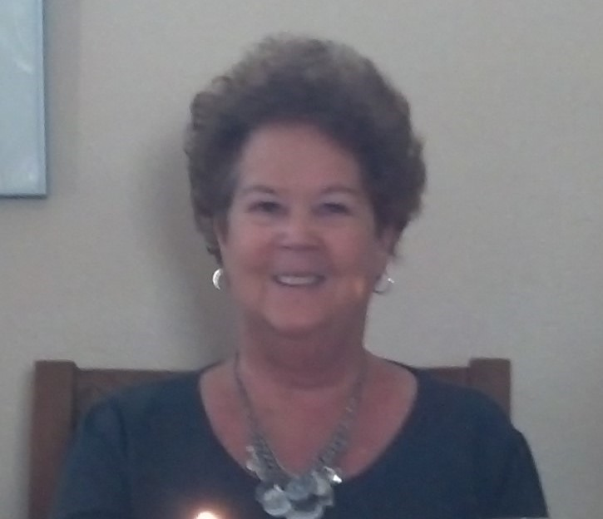
Jane Roberts, School of Social Work Sarasota-Manatee campus
Promoted to Instructor III

Slide 35
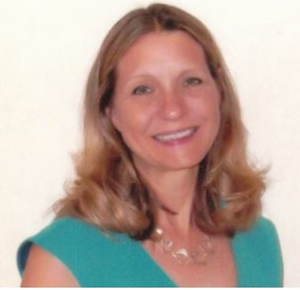
Donna Polelle, Communication Sciences & Disorders Sarasota-Manatee campus
Promoted to Instructor III

Slide 36
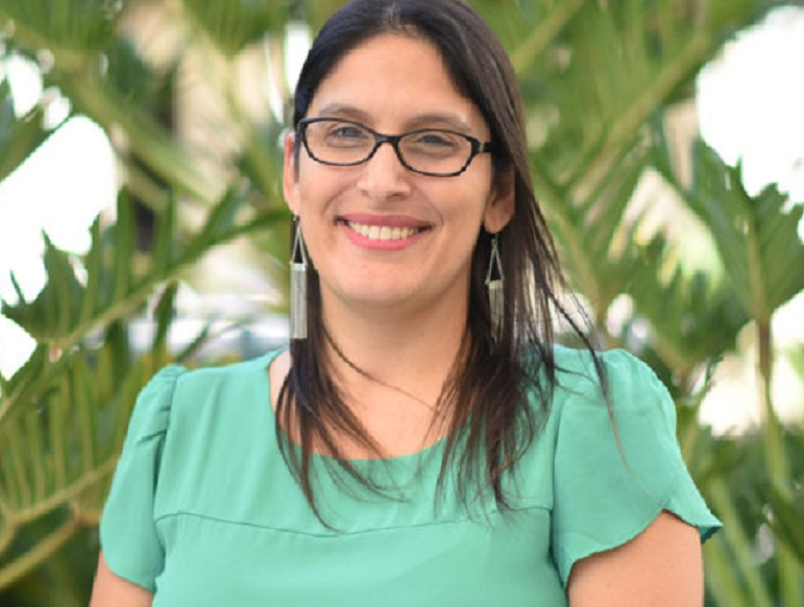
Jenna Luque, Communication Sciences & Disorders Sarasota-Manatee campus
Promoted to Instructor II

Slide 37
CBCS Tenure &Promotion Applications
​T&P Applications for 2020-21
Associate: 0
Full: 0
Research Associate: 0
Research Professor: 2
Instructor: 4
Mid-tenure review: 0

Slide 38
CBCS Curriculum Committee Andrea Smith, Chair

Slide 39
Curriculum Committee Charge
​Meets monthly in Fall and Spring semesters.
Reviews all proposals for new undergraduate/graduate courses and programs, including minors and certificates.
Reviews all substantive undergraduate/graduate catalog changes, and curriculum changes.
Makes recommendations to the USF Undergraduate Council and Graduate Council regarding action on proposals.
New this Fall: USF implemented new course and curriculum proposal system, Curriculog.
Note: all catalog changes for 2021-22 must be submitted in Curriculog by January 25, 2021.

Slide 40
Curriculum Committee 2020-2021
​Child & Family Studies – Amanda DePippo​
Communication Sciences & Disorders – Andrea Smith​, Chair
Criminology – Andrew Franz​
Mental Health Law & Policy – Khary Rigg​
School of Aging Studies – Bill Haley​
School of Social Work – Dawn Brown

Slide 41
CBCS Diversity & Inclusion Committee Maria Carlo, Chair

Slide 42
CBCS Diversity & Inclusion Committee​ Members​
Maria Carlo, Child & Family Studies, Chair
Kerianne Beckford, Dean’s Office
Kwang-Sun Blair, Child & Family Studies
Yazmin Castellano, Child & Family Studies
Jerome Galea, School of Social Work
Rocky Haynes, Child & Family Studies
Alejandra Montoya, Dean’s Office
Cheryl Paul, Communication Sciences & Disorders
Therese Sandomierski, Child & Family Studies
Michon Shaw, Communication Sciences & Disorders
Melissa Thompson, School of Social Work
Tracy-Ann Gilbert-Smith, Child & Family Studies
Soomi Lee, School of Aging Studies
Guitele Rahill, School of Social Work
Swain William, Mental Health Law & Policy
Lori Hall, Criminology

Slide 43
Graduate Course Diversity Audit 2019-2020
​Committee surveyed graduate courses in CBCS as part of a self-study intended to satisfy criteria for recognition under the National Model Excellence for Diversity & Inclusion Model.
Graduate course titles and descriptions in CBCS departments offering masters and doctoral degrees were examined for a total of 108 key words related to diversity and inclusion.
Courses with titles or descriptions that contained one or more key words were flagged.

Slide 44
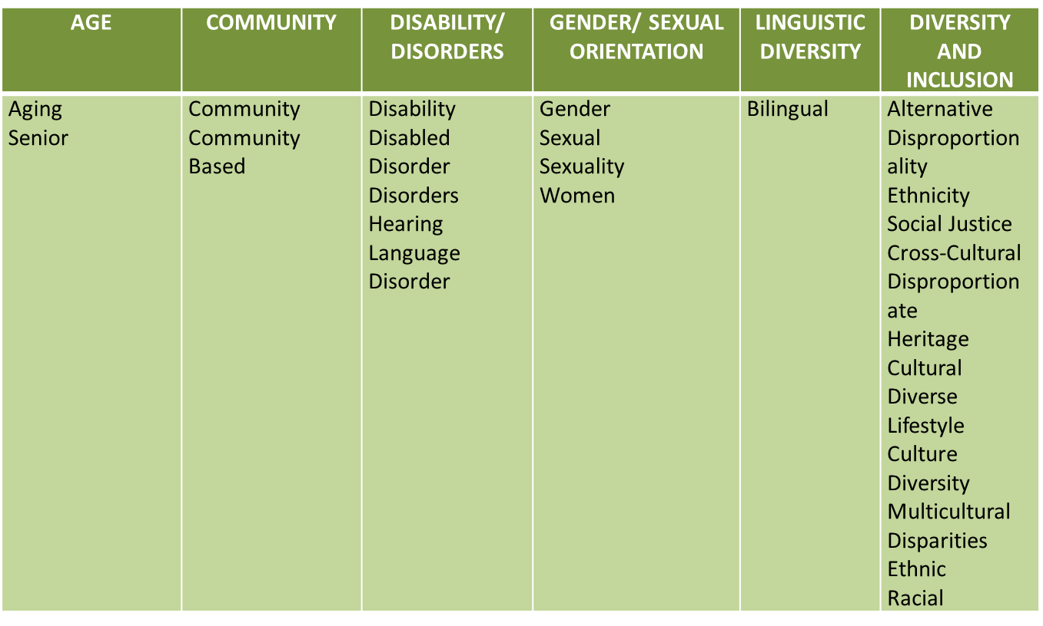
Terms Found

Slide 47
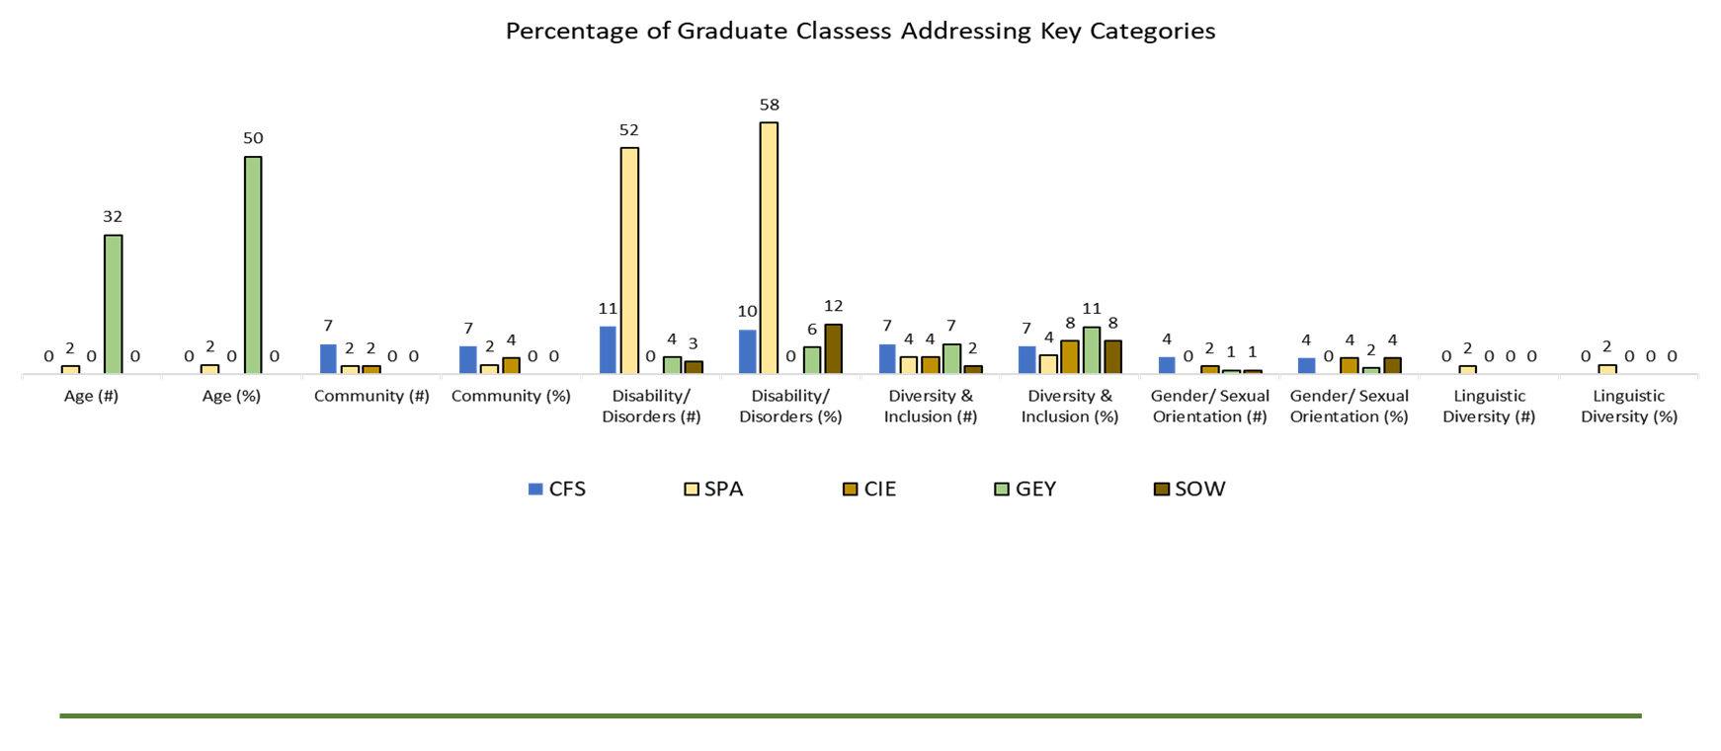
Percentage of Graduate Classes Addressing Key Categories

Slide 48
Committee’s Recommendation
​Departments engage in conversation about courses that do/do not cover key concepts to promote equity and consider revising course descriptions to reflect that content to the university community.
Revision of course descriptions to reflect use of person-first language.

Slide 49
CBCS Research Council Update Howard Goldstein, Associate Dean for Research Marilyn Stern, Research Council Chair

Slide 50
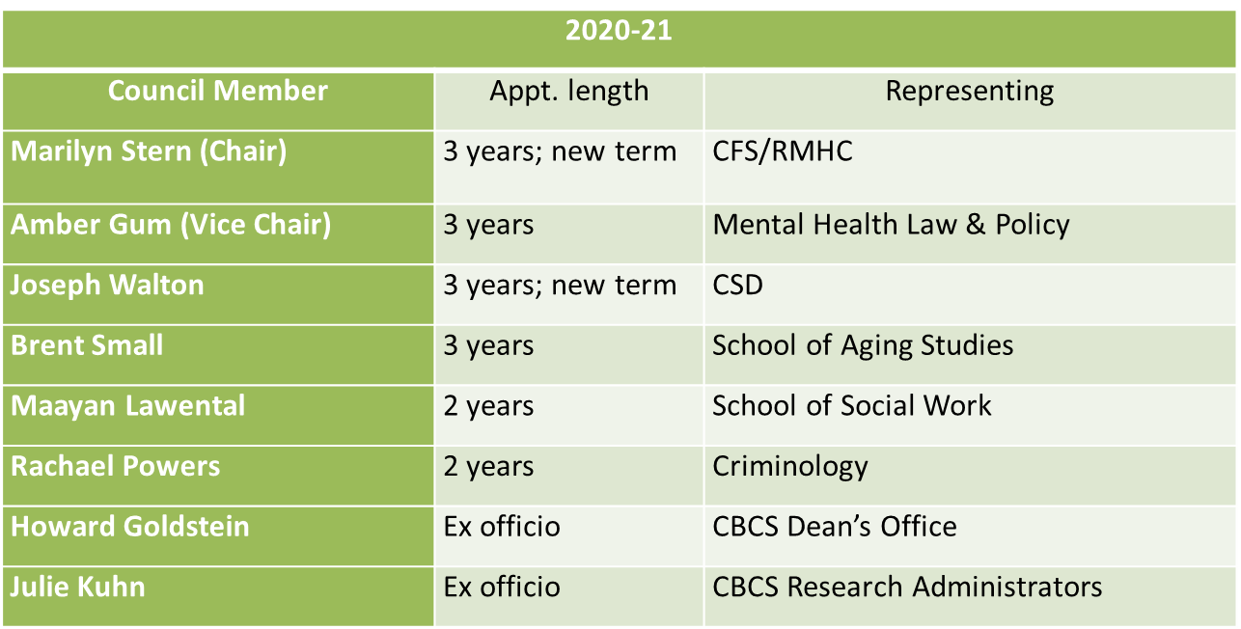
Research Council Members 2020-2021​

Slide 51
Awards & Grant Due Dates
Update for Fall grant proposals:
International Collaboration Grant Awards cancelled due to travel restrictions. Faculty are encouraged to continue collaborations virtually. The council will revisit a new award cycle in the Spring semester.
CBCS Internal Grants due: November 16th
CBCS Grants on Addressing Blackness and Anti-Black Racism (TBA)

Slide 52
Report on CBCS Contract & Grant Activity

Slide 53
Dean’s Report ​and Q&A​ Dean Julie Serovich

Slide 54
Strategic Planning

Slide 55
CBCS Strategic Plan Goals

Slide 56
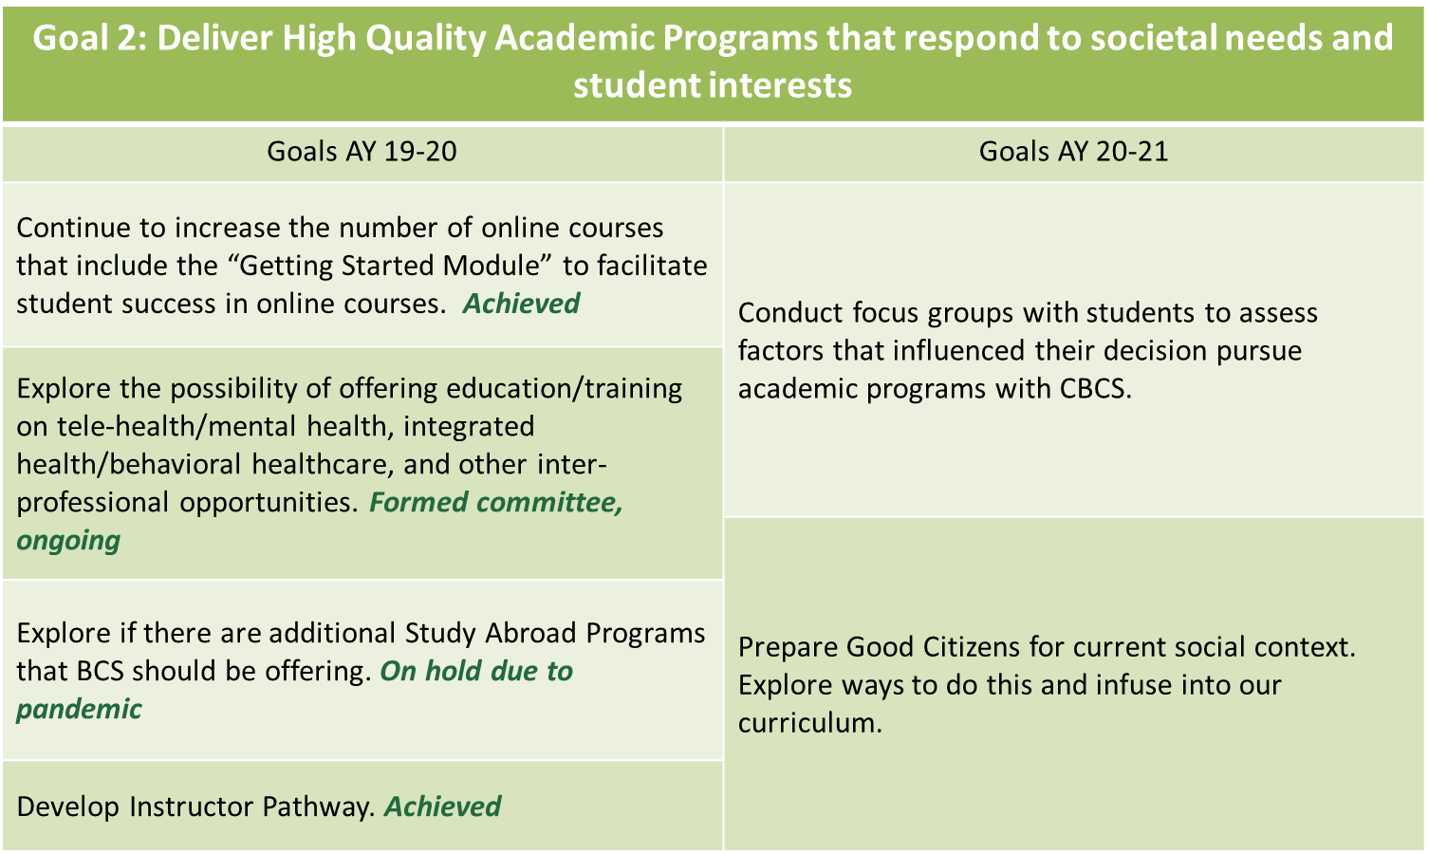
CBCS Strategic Plan Goals

Slide 57
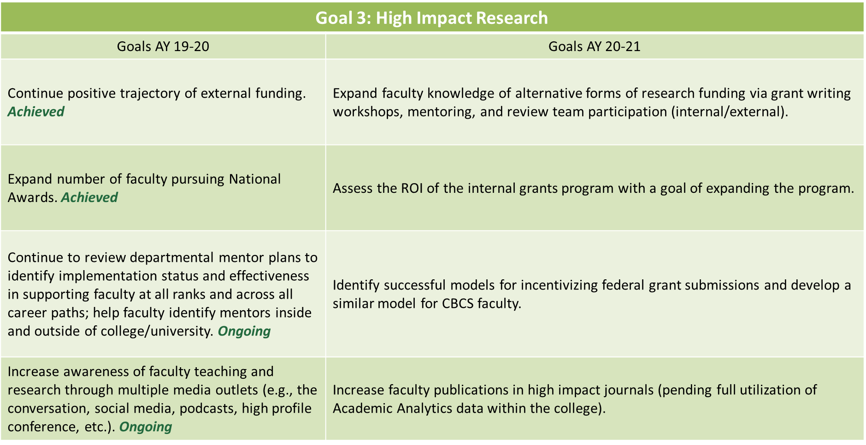
CBCS Strategic Plan Goals

Slide 58
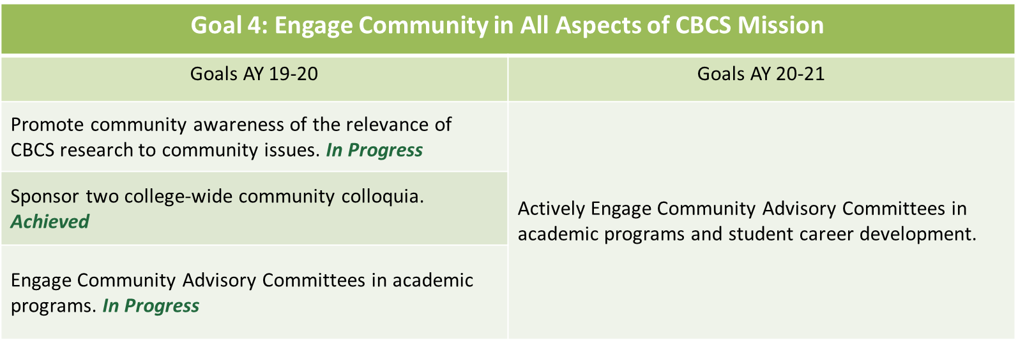
CBCS Strategic Plan Goals

Slide 59
CBCS Strategic Plan Goals

Slide 60
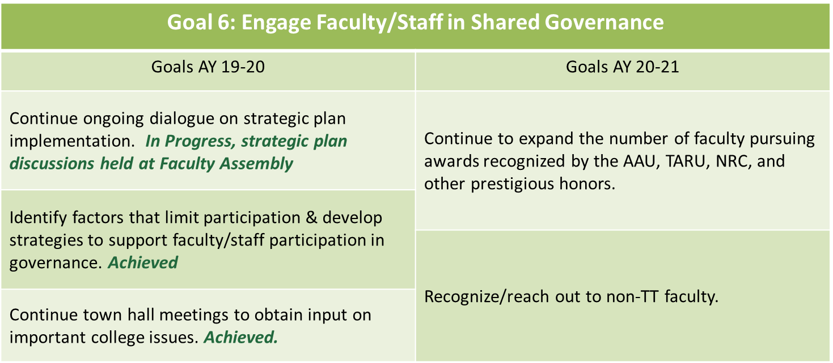
CBCS Strategic Plan Goals

Slide 61
CBCS FY21 Budget Overview

Slide 62
Budget

Slide 63
Reduction Exercise

Slide 64
Guiding Principles for Budget Reduction Exercise
Our budget reduction plan was lead by the following four principles:
1. Preserve jobs
2. Maintain student success metrics
3. Preserve our research agenda
4. Preserve our rankings

Slide 65
What did we do at each level of cut?
At the 5% reduction level we focused on vacant salary rate and non-salary base.
At the 10% reduction level we focused on anticipated non-reappointments, redistribution of salaries to non-E&G funding sources, DROP retirements pre-2022, and non-salary base.
At the 12.5% reduction level we added DROP retirements post-2022, program restructuring, and a potential Staff position elimination or redistribution to auxiliaries.
At the 15% reduction level we added potential Admin and Staff position eliminations or redistribution to auxiliaries.

Slide 66
Actual Reduction

Slide 67
How the cuts will be taken in year 1

Slide 68
How our budget will look after year 1 and 2

Slide 69
How we can achieve year 2 cuts
FY21-22 E&G Budget Reduction Options
Retirements
Non-Salary
Faculty Rate plus Fringe
Non-Faculty Rate plus Fringe
Moving lines to alternate funding sources

Slide 70
Other Updates

Slide 71
Questions

Slide 72
Faculty Presentations:

Slide 73
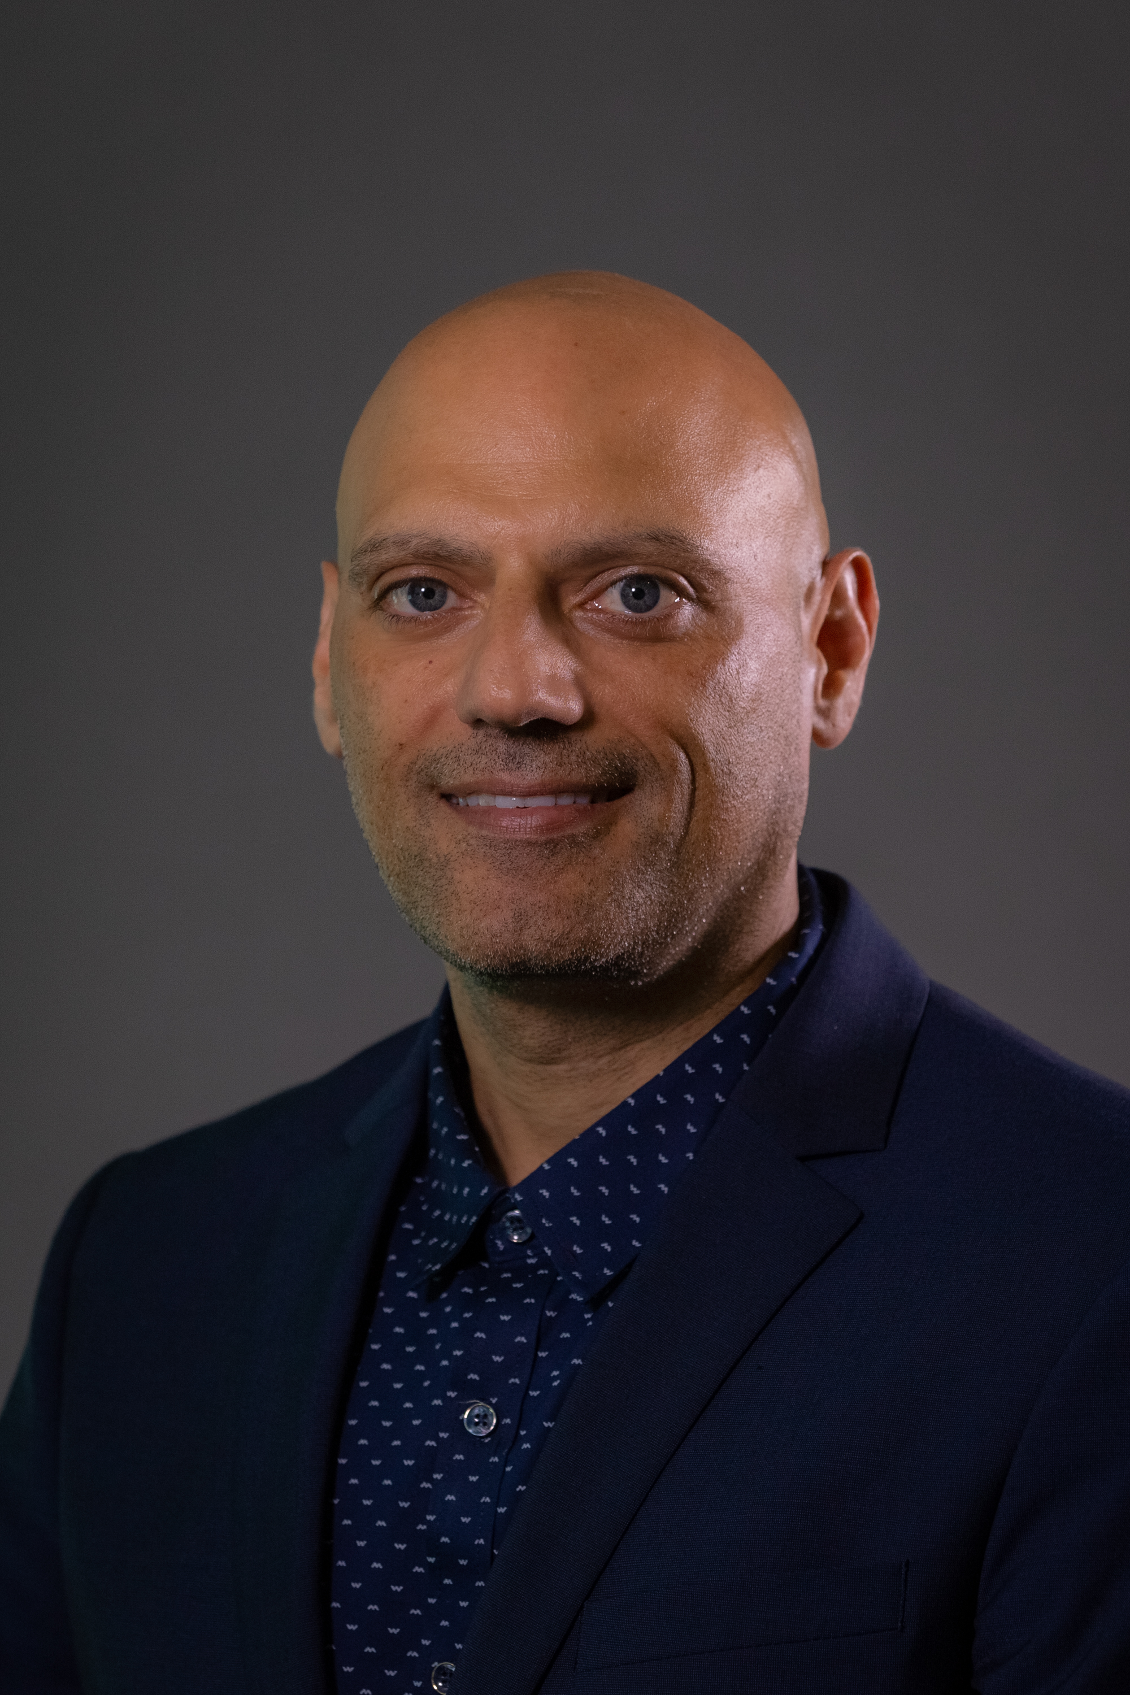
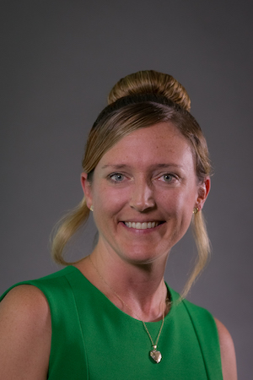
Presenters
Jerome Galea, PhD, MSW Assistant Professor, School of Social Work
Kristin Kosyluk, PhD, CRC Assistant Professor, Department of Mental Health Law & Policy

Slide 76
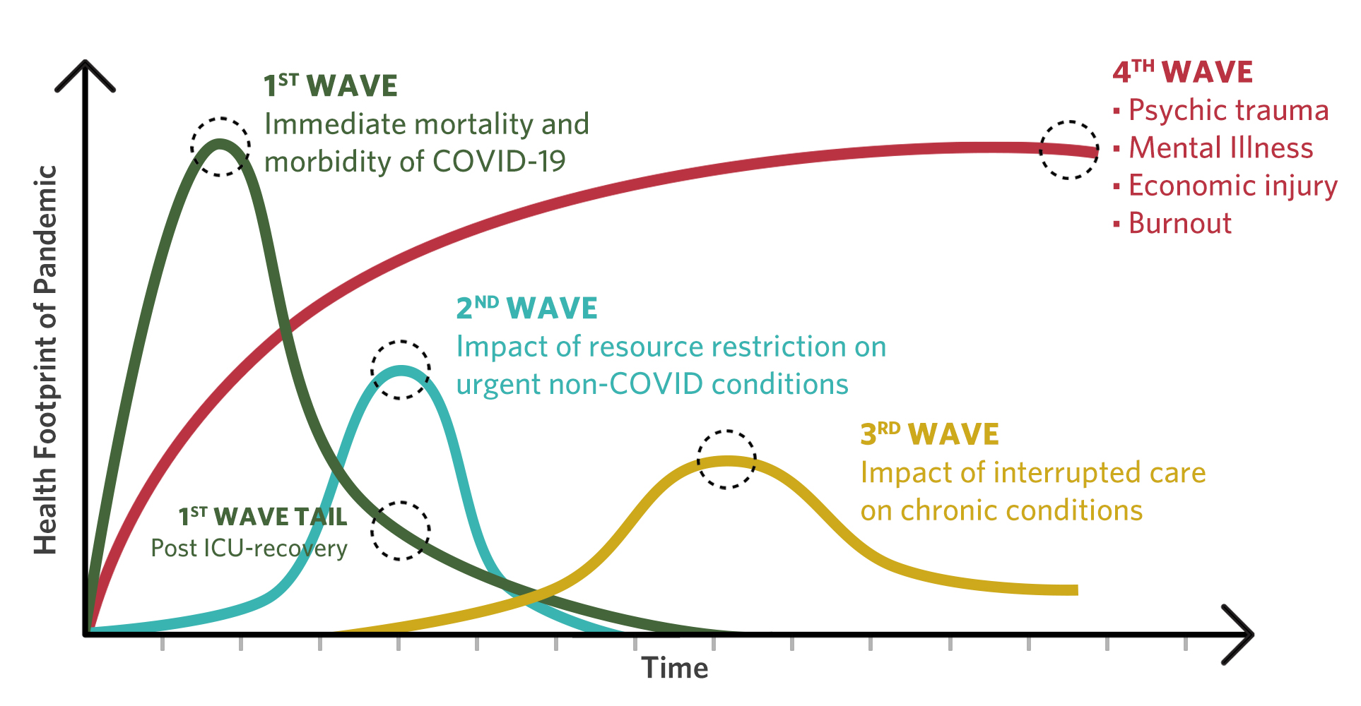
The mental health “curve”

Slide 77
The mental health “curve” Both a near-term and long-term response is needed

Slide 78
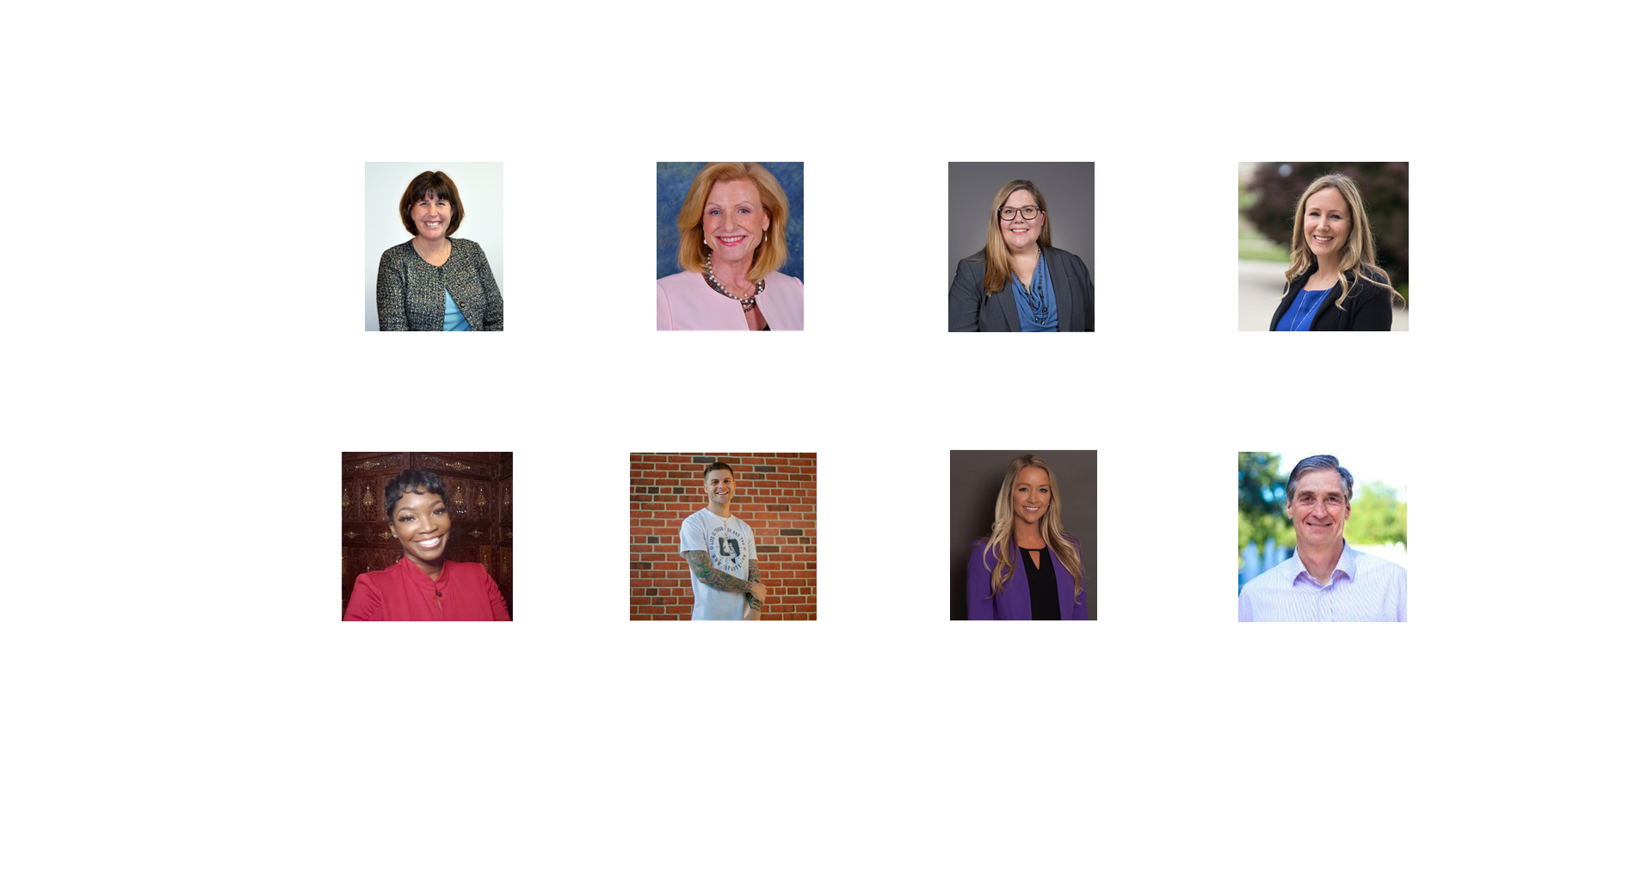

Slide 79
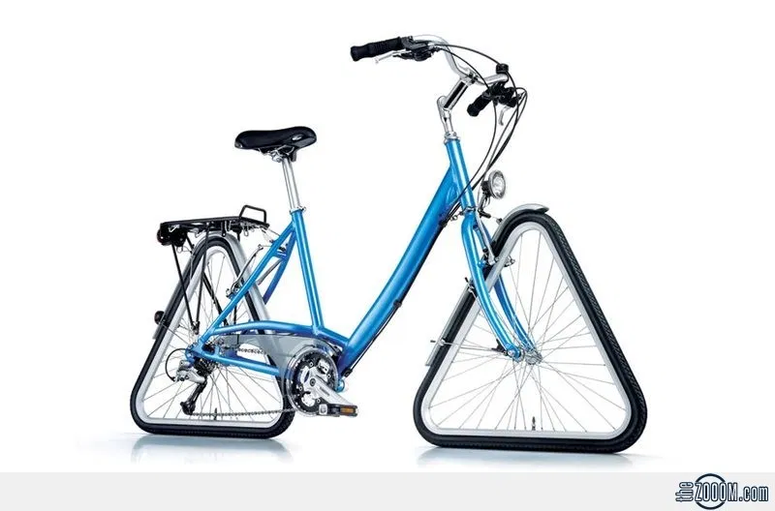
What We Want / What We Don't Want

Slide 80
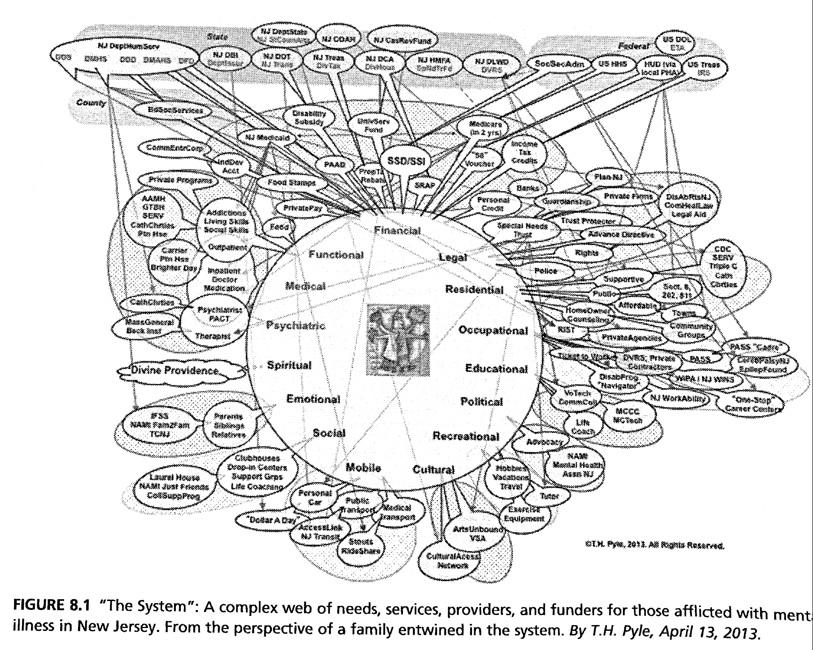
What We Want / What We Don't Want
(Pratt, Gill, Barrett, & Roberts, 2014)

Slide 81
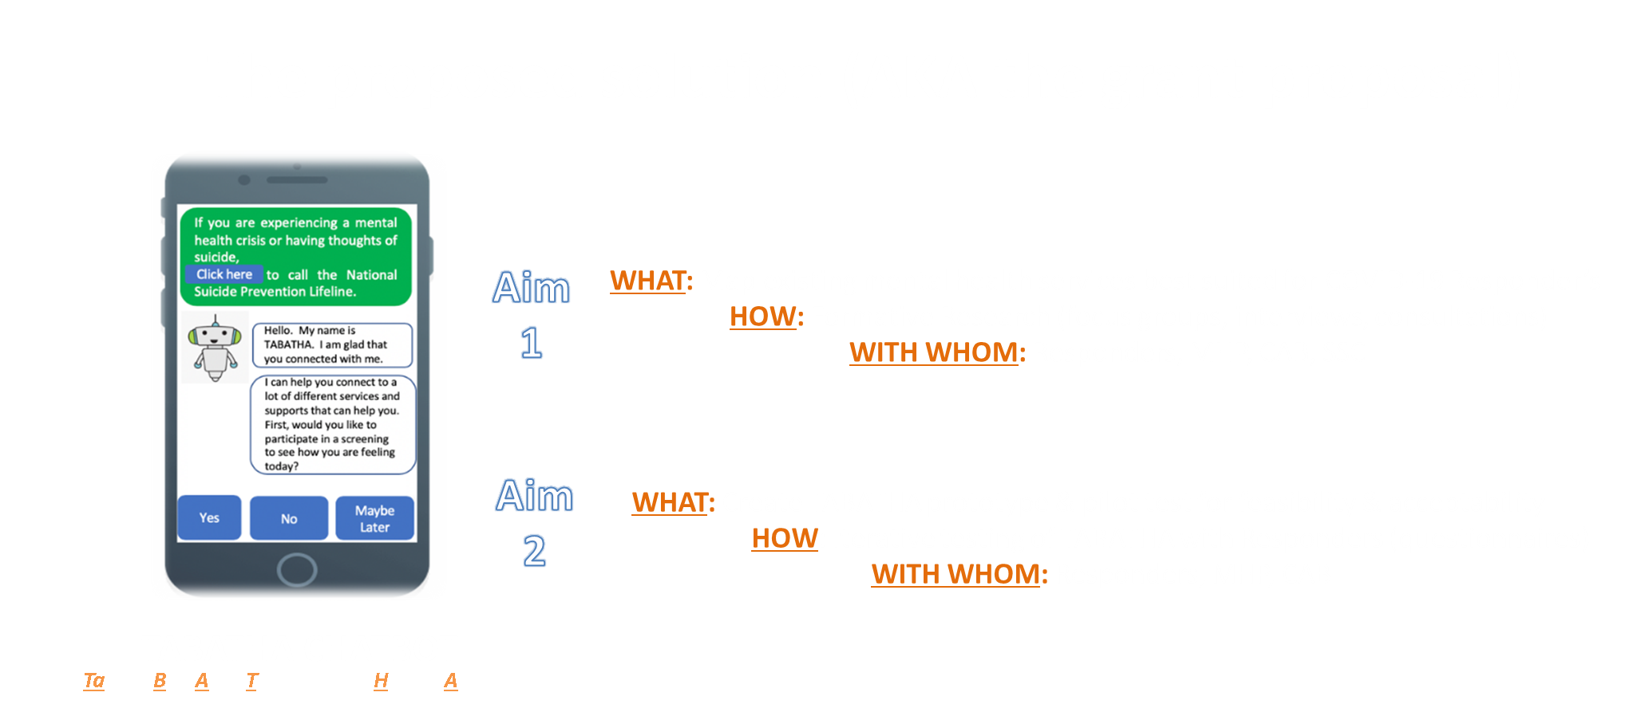

Slide 82
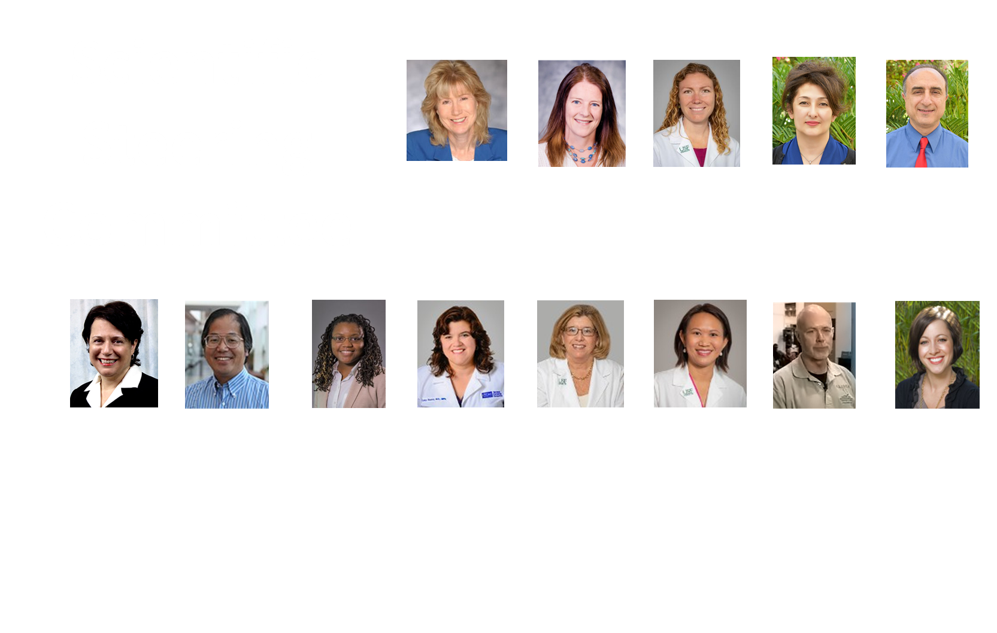

Slide 83
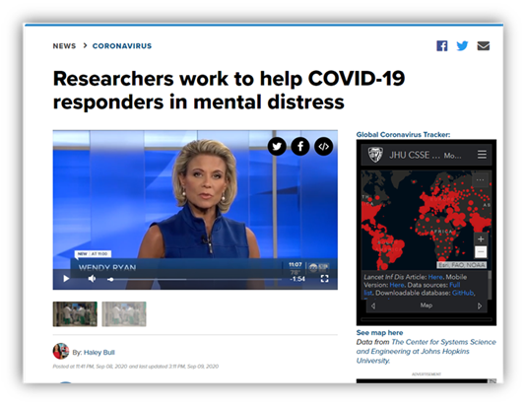

Slide 84
TABATHA Measures
Measure​ | Target​ | Rationale​
PHQ-9​ | Depression Symptoms​ | Self-administered, easy to use​
GAD-7​ | Anxiety Symptoms​ | Self-administered, easy to use​
Perceived Devaluation Discrimination Scale​ | Perceived Stigma​ | Aid in providing appropriate services based on stigma measure​
The Self-Stigma of Seeking Help Scale​ | Label Avoidance​ | Aid in providing appropriate services based on stigma measure​

Slide 85
Other Measures
Measure​ | Target​ | Rationale​
Attitudes Towards Mental Health Treatment​ | Mental Health Treatment Attitude​ | Aid in providing appropriate services based on attitudes toward treatment​
University of Rhode Island Readiness for Change Assessment (URICA)​ | Readiness for change​ Stage of Change​ | Aid in providing appropriate services based on stage of change​
Perceived Stress Scale​ | Perceived Stress​ | Required by NIH​
WHODAS 2.0​ | Health and Disability​ | Short, Simple, Easy to administer​

Slide 86
Other Measures
Measure​ | Target​ | Rationale​
PCL-5 with LEC-5 and Criterion A | Trauma​ | Non-Proprietary; Guidance from SSC
PhenX-Broad Psychopathology​ ​ | Common psychology symptoms​ | Required by NIH​
Technology Readiness Index2.0​ | Technology Readiness​ | Examining level of readiness for the use of chat bot technology in mental health service navigation, examine potential relationship with TABATHA acceptability​

Slide 87
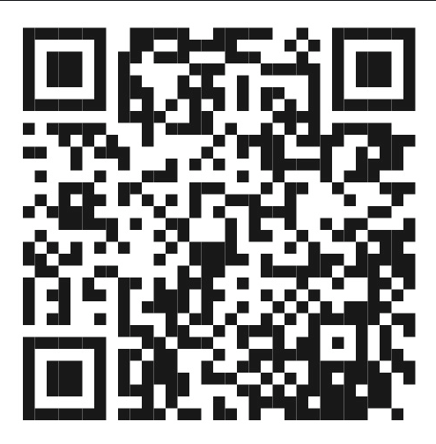
What might TABATHA Look like?
Users would scan a
and then…

Slide 89
Thank You for Attending!

