Slide 1
School Mental Health
Including Threat Assessment,
School Safety, and Trauma
October 2, 2020
College of Behavioral & Community Sciences, Louis de la Parte Florida Mental Health Institute

Slide 2
School Mental Health
Including Threat Assessment,
School Safety, and Trauma
October 2, 2020
Thanks to our Generous Sponsor:
Drs. Carl and Cynthia Hawkins

Slide 3
Best Practices in School Behavioral Health
Mark D. Weist
Professor, University of South Carolina
USF School Mental Health Colloquium, October 2, 2020

Slide 4
School Behavioral Health (SBH) Definition
Mental health – education system partnerships, with clinicians joining school-employed mental health staff and educators to improve the depth, quality, and impact of promotion/prevention (Tier 1), early intervention (Tier 2), and treatment (Tier 3) programs in schools

Slide 5
Outline
School Mental Health (SMH)
Positive Behavioral Interventions and Supports (PBIS)
Interconnected Systems Framework for SMH and PBIS
Key Features: District-Community Leadership Team, Alignment, Screening, Family/Student Engagement/Leadership, Reducing Inequities
COVID-19 Interface
Resources and the Behavioral Alliance of South Carolina (BASC)

Slide 6
“Expanded” School Mental Health
Full continuum of effective mental health promotion and intervention for students in general and special education
Reflecting a “shared agenda” involving school-family-community system partnerships
Collaborating community professionals (not outsiders) augment the work of school-employed staff

Slide 7
Roles of School-Employed MH Staff (in some instances)
Course scheduling
Attendance monitoring
Examination monitoring
Career guidance
Logistics assistance
  See Steve Evans, Ohio University

Slide 8
Advantages
Improved access
Improved early identification/intervention
Reduced barriers to learning, and achievement of valued outcomes
WHEN DONE WELL

Slide 9
But
SMH programs and services continue to develop in an ad hoc manner, and
LACK AN IMPLEMENTATION STRUCTURE

Slide 10
Maternal and Child Health Bureau/Health Resources and Services Administration
Mental Health in Schools Initiative, 1995
Two National Centers
  University of Maryland School of Medicine (UMSM)
  University of California, Los Angeles
Five States
  Kentucky, Maine, Minnesota, New Mexico, South Carolina
National Center for School Mental Health at UMSM still going strong in its 25th year (see www.schoolmentalhealth.org)

Slide 11
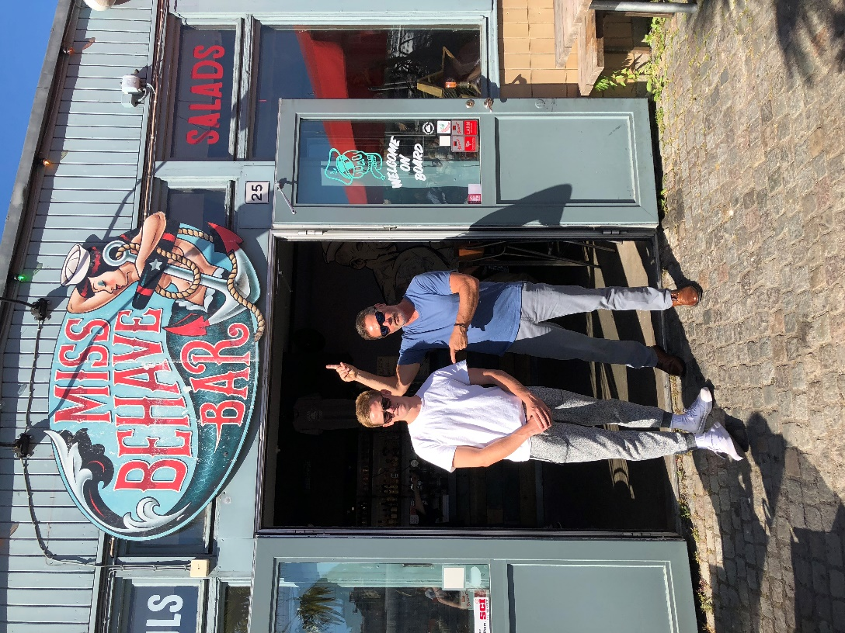
Nate, age24

Slide 12
Positive Behavior Intervention and Support (www.pbis.org)
In around 27,000 schools
Decision making framework to guide selection and implementation of best practices for improving academic and behavioral functioning
  Data based decision making
  Measurable outcomes
  Evidence-based practices
  Systems to support effective implementation

Slide 13
Advantages
Promotes effective decision making
Reduces punitive approaches
Improves student behavior
Improves student academic performance
WHEN DONE WELL

Slide 14
But
Many schools implementing PBIS lack resources and struggle to implement effective interventions at Tiers 2 and 3
View student issues through lens of “behavior”

Slide 15

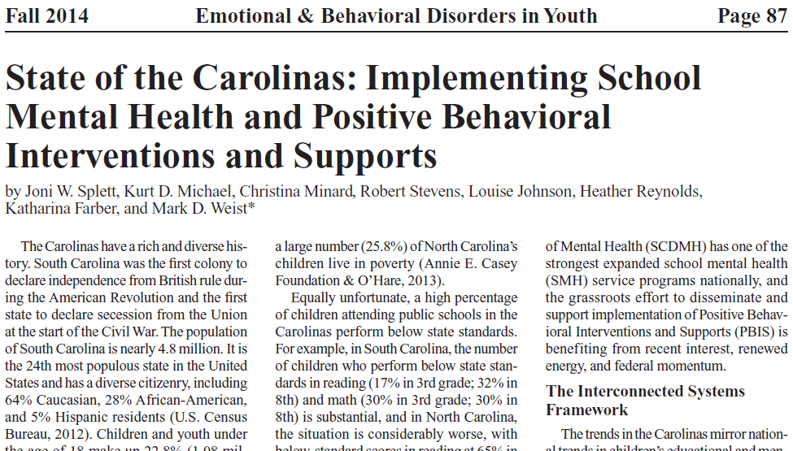
Mapping PBIS and SMH

Slide 16

Social, Health, Emotional, Behavioral and Academic (SHEBA)

Slide 17


Slide 18
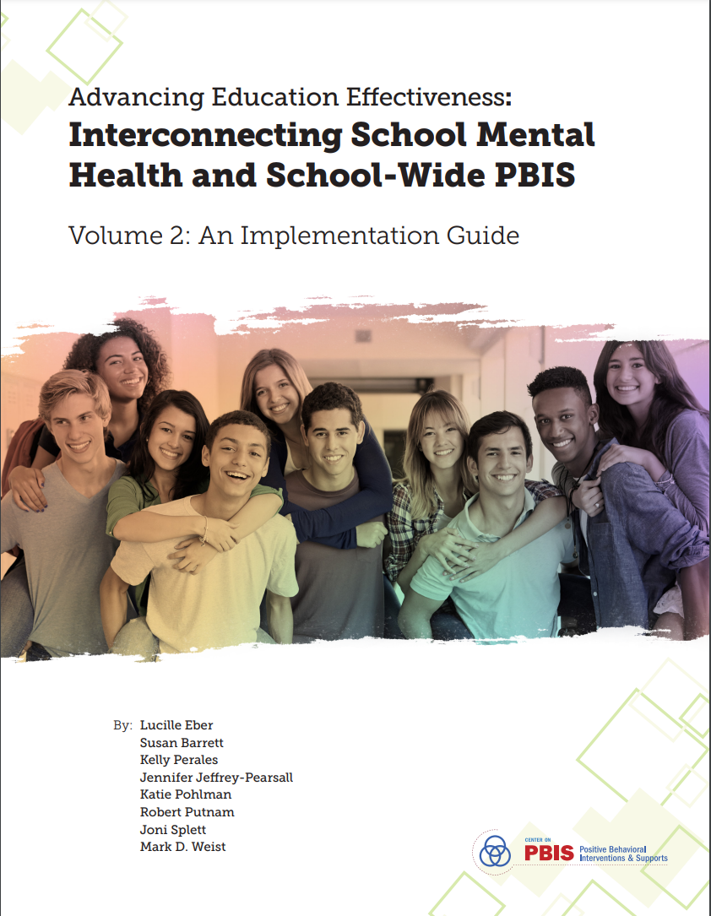

Slide 19
ISF Defined
  A strong, committed and functional team including mental health system staff guides the work, using data at three tiers of intervention
  Sub-teams having “conversations” and conducting planning at each tier
  Evidence-based practices and programs are integrated at each tier, with implementation support and coaching
  SYMMETRY IN PROCESSES AT STATE, DISTRICT AND BUILDING LEVELS

Slide 20
ISF Conceptual Framework
Improved behavioral/academic outcomes for all
Greater depth and quality in services
Improved data use, team functioning
Systematic MOAs
Strong district/building leadership
A SHARED AGENDA
Intervention
Prevention – Early Intervention
Prevention/Promotion for All

Slide 21
Three Connected Priorities
Implement effective practices
Document valued outcomes
Build capacity

Slide 22
District-Community Leadership Team
Systems leaders (e.g., School Superintendent, MH Agency Leader)
Those involved in ISF coaching (from EDU and MH)
Educators (including principals) and clinicians
Family members and older youth
Representatives from other diverse youth-serving systems (e.g., child welfare, juvenile justice, disabilities, primary healthcare)
Government officials
University staff and researchers

Slide 23
Stakeholders (Leaders and Staff)
Youth and Families
Government
Education
Child and Adolescent Mental Health
Juvenile Justice
Child Welfare
Disabilities
Primary Healthcare
Allied Health Services
Vocational Rehabilitation
Universities and Colleges
Faith
Business

Slide 24
Role/Function of the DCLT
Notes:
This graphic should look familiar. This is a revised version from the most recent Implementers Blueprint. Think about the way your DCLT currently operates? What needs to happen to improve? For many teams they have delivered well with training/coaching/building local content expertise and have local sites that serve as PBIS champions. But many sites still struggle with leveraging funding, visibility, political support, policy/system alignment and personnel readiness/selection…it’s the top tier that really needs cabinet level authority –
What is your current status and how will MH help/hinder ?

Slide 25

Why Alignment is Important
“One of the major variables affecting sustained implementation of effective practices is the introduction of new initiatives that either (a) compete with resources needed for sustained implementation or (b) contradict existing initiatives”
  McIntosh (2015)
Notes:
From:
Alignment, Implementation and Educational Excellence
Presentation at OSEP IDEA Conference 2015
Steve Goodman --- Michigan (MiBLSi)
Rob Horner --- University of Oregon

Slide 26
Analyses SAMHSA, NREPP Program Costs (Melissa George et al., 2013)
For Profit N= 32 | Year 1 $7909-10661 | Year 2 $5788
Non Profit N=36 | $3122-3584 | $106
Public Domain N=6 | Minor Costs? | Minor Costs?
Not Determined N=9 | $1596 | $33

Slide 27
180% increase in identified need with screener
Splett et al., (2018). Comparison of Universal Mental Health Screening to students already receiving intervention in a multitiered system of support. Behavioral Disorders, 43(3), 344-356. https://doi.org/10.1177/0198742918761339
Notes:
8 schools already serving 10% of student population
BESS identified students not already receiving services and that represented 18.4% of student population.
If started serving addition 18.4 on top of 10.1 it would represent a 180% increase in services
Add’l analyses indicate large portion of those newly identified had discipline, grade, attendance risk but at lower levels than those already being served – tier 2 level needs newly identified

Slide 28
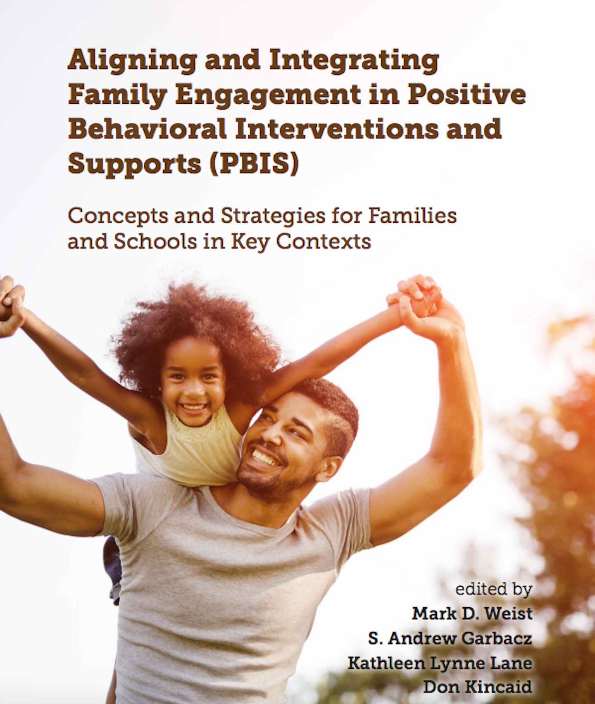

Slide 29
Ladder of Student Involvement
Notes:
1. The Ladder is not designed to be applied to a whole school at once; instead, use it to assess individual activities.
Simply calling something “meaningful” doesn’t make it so.
2. There is an active debate among young people, educators, and others about the placement of rungs 7 and 8. Which is more meaningful? Meaningful student involvement should build community in schools while empowering students, which makes activities that students initiate and share decisions with adults most important.
3.The rungs are not a process that happens in order. Activities can go from the second rung directly to the sixth; sometimes, they’ll be on two rungs at different ends of the Ladder at once, depending on who is looking.
8) Student-Adult Partnerships. Students initiate action and share decision-making with adults. Meaningful student involvement is integrated into school improvement at every level. Students are authorizing with the authority to create change, and incorporated throughout school improvement activities.
7) Student-Initiated, Student-Led. Meaningful student involvement is propelled by students and creates opportunities for students to initiate and direct projects, classes, or activities. Adults are involved only in supportive roles.
6) Adults Initiate Action and Share Decisions with Students. Students are involved in designing projects, classes, or activities that are initiated by adults. Many activities, including decision-making, teaching, and evaluation, are shared with students.
5) Students Consulted by Adults. Students give advice on projects, classes, or activities designed and run by adults. The students are informed about how their input will be used and the outcomes of the decisions made by adults.
4) Students Assigned to be Involved. Student involvement is assigned by teachers, who assign specific roles, determine how, and teach students why they are being involved.
3) Tokenism – Students appear to be given a voice, but in fact have little or no choice about what they do or how they participate.
2) Decoration – Students are used to help or bolster a cause in a relatively indirect way; adults do not pretend that the cause is inspired by students. Causes are determined by adults, and adults make all decisions.
decisions.
1) Manipulation – Adults use students to support causes by pretending that those causes are inspired by students.

Slide 30

Family-School-Community Alliance (https://fsacalliance.org)
Promote family, youth, and community engaged partnerships in research, practice, and policy to improve prevention and intervention in the systems and practices of positive behavioral interventions and supports and related multitiered systems of support toward improvement in valued outcomes
Notes:
The FSCA works to Promote family, youth, and community engaged partnerships in research, practice, and policy to improve prevention and intervention in the systems and practices of positive behavioral interventions and supports and related multitiered systems of support toward improvement in valued outcomes.

Slide 31

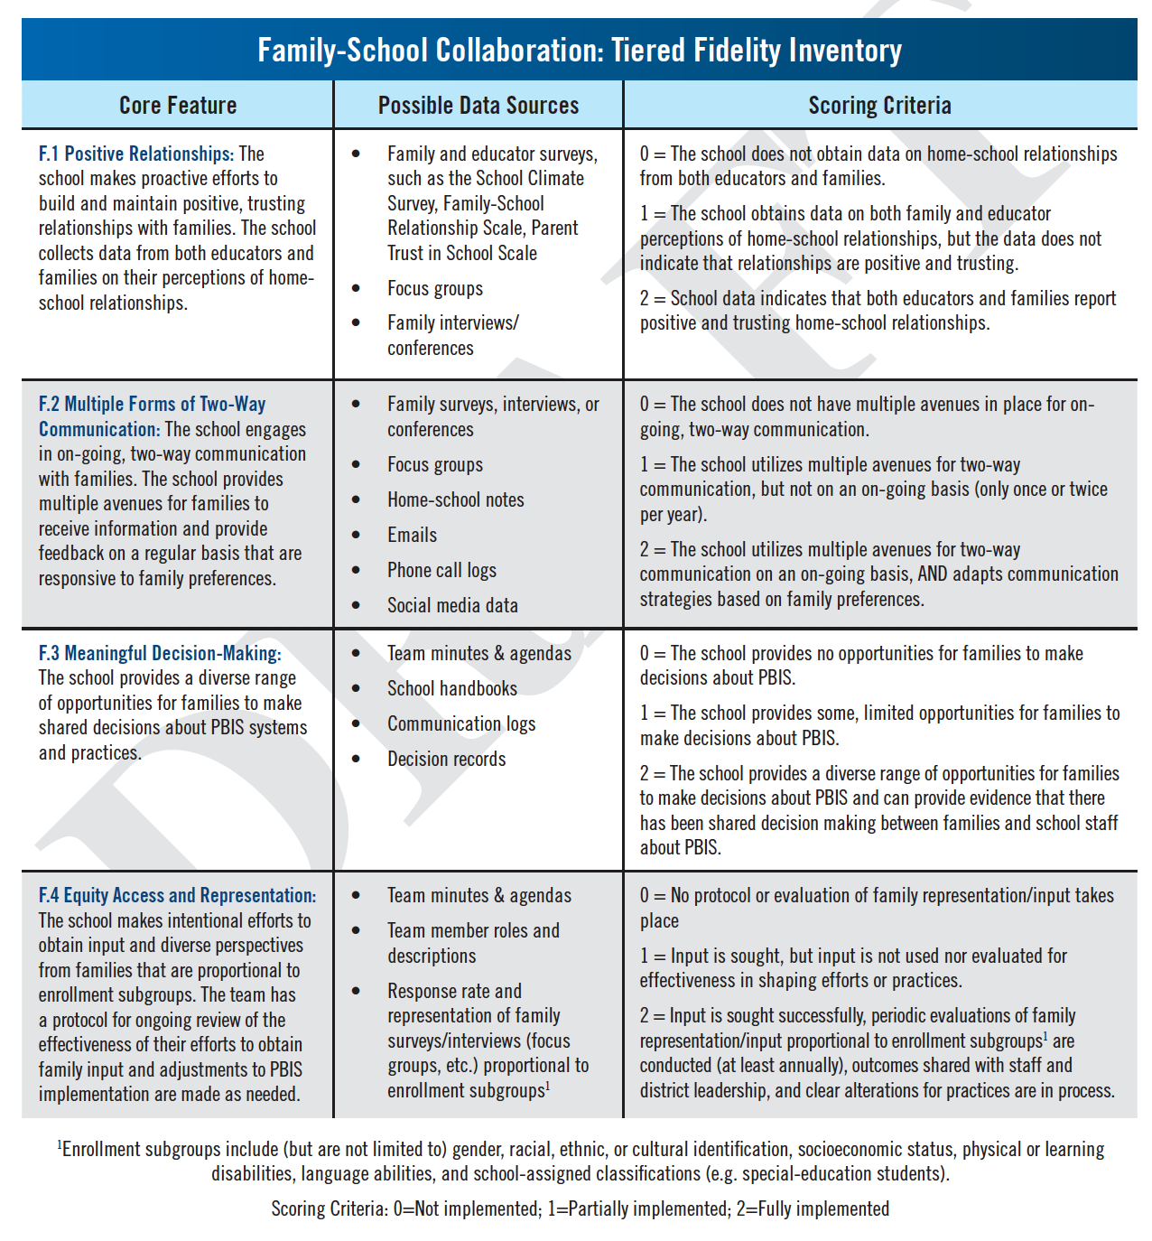
Tiered Fidelity Inventory: Family-School Collaboration (TFI: FSC)
Development
Content Validity
  Expert Review
Pilot Site Recruitment
Notes:
Andy

Slide 32
TFI: FSC
A Fidelity Tool to Assess Implementation of FSC in PBIS
Family-School Collaboration: Tiered Fidelity Inventory
Domain 1: Positive Home-School Relationships
Positive Relationships | Strategies for positive, trusting family-school relationships
Effectiveness of Positive Relationships | Assesses effectiveness of efforts to build positive relationships
Domain 2: Two-Way Communication
Assessment of Family Preferences for Two-Way Communication | Assesses family preferences for two-way communication
Multiple Forms of Two-Way Communication | Provides multiple avenues for two-way communication
Domain 3: Shared Decision Making
Shared Decision Making | Provides diverse opportunities for making shared decisions
Systematic Process for Shared Decision Making | Clear and written process for ongoing review of obtaining family input
Equitable Access and Representation in Decision Making | Efforts to obtain input proportional to enrollment subgroups
Notes:
Andy

Slide 33
TFI: FSC
A Fidelity Tool to Assess Implementation of FSC in PBIS
Family-School Collaboration: Tiered Fidelity Inventory
Domain 4: Family Voice for Equitable Discipline
Family Voice for Equitable Discipline | Efforts to obtain perspectives of families who have students experiencing disproportionate rates of exclusionary discipline
Clear Process for Using Family Voice in Equitable Discipline | Reviews input from families and makes necessary adjustments
Domain 5: Training and Support for Family-School Collaboration
Training and Support Options for School Staff | Supports for staff to use family-school collaboration
Training and Support Options for Families | Supports for families to use family-school collaboration
Domain 6: Evaluation
Evaluation (Goals) | Families and school staff develop goals and outcomes
Evaluation (Progress Monitoring) | Families and educators develop strategies for monitoring progress
Evaluation (Data-Based Decision Making) | Families and educators develop data review procedures
Notes:
Andy

Slide 34



Project RISE*
Colleen Halliday-Boykins
Assistant Professor
Joni Splett
Assistant Professor
Mark D. Weist
Professor
Kent McIntosh, University of Oregon
Patricia Devine, University of Wisconsin-Madison
Clayton Cook, University of Minnesota
Kelly Perales, Midwest PBIS Network
*Funded by the National Institute of Minority Health and Disparities
Arthur Andrews, III, University of Nevada, Lincoln
Jason Chapman, Oregon Social Learning Center
Nancy Lever, University of Maryland

Slide 35
Project RISE BOOST Training/Coaching Elements
Data-based decision making for staff
Teacher wellness and stress reduction
Addressing teacher unintentional racial/ethnic bias
Addressing student unintentional racial/ethnic bias
Identifying vulnerable decision making points, and building neutralizing routines

Slide 36
Key Wellness Strategies
Stress reduction, reframing of stress and abilities to cope with it*
Social support* (connect together)
Decreasing cell phone and social media use
Sleep
Mindfulness
Zen involvement in nature
Exercise
Nutrition
Cognitive coping
Notes:
Cell phone use related to increased distress and sleep problems

Slide 37

Cause I Ain’t Got a Pencil by Joshua T. Dickerson
I woke myself up
Because we ain’t got an alarm clock
Dug in the dirty clothes basket,
Cause ain’t nobody washed my uniform
Brushed my hair and teeth in the dark,
Cause the lights ain’t on
Even got my baby sister ready
Cause my mama wasn’t home.
Got us both to school on time
To eat us a good breakfast.
Then when I got to class the teacher fussed
Cause I ain’t got a pencil

Slide 38



Slide 39

University of South Carolina
School Behavioral Health Team
Department of Psychology
USC Team: Mark Weist, Taylor Davis, Erin Scherder,
Katherine Widener, June Greenlaw, Tricia Motes,
Frances Bradshaw, Darien Collins, and Bob Stevens

Slide 40


April 15-16, 2021
Myrtle Beach, SC (in-person and virtual)

Slide 41




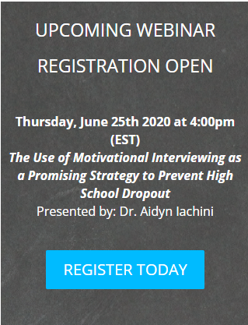

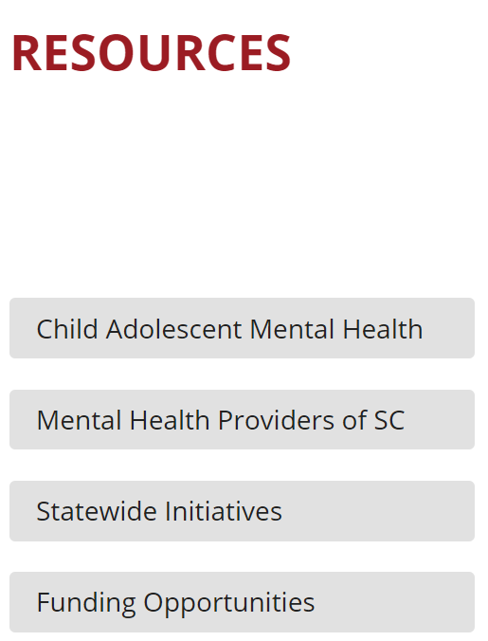
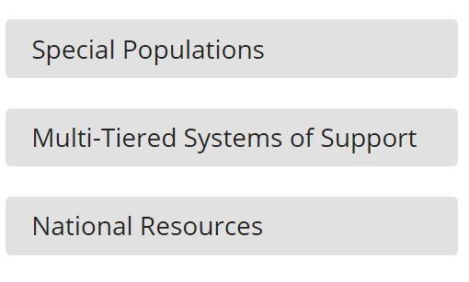
Realm 2
Webinars
Newsletters
Repository

Slide 42


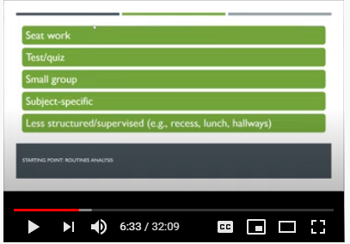
Realm 2- Virtual Enhancements
BASC’ing in the Spotlight
Working Through It Wednesday
Caregiver Corner
Pitfalls of FBA with Dr. Anderson
Funny & Skills Based Videos
Spotlighting Travis Hodges, School Bus Driver
Video Playlist on Youtube: Southeastern School Behavioral Health Community

Slide 43

University of South Carolina
School Behavioral Health Team
Department of Psychology
Click our Webinar tab to find upcoming national webinars and recordings of previous presentations!
www.schoolbehavioralhealth.org/basc/

Slide 44
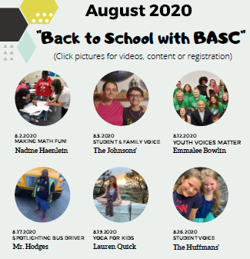





3 Ways to Stay Connected
Monthly Flyer
2. Calendar of Events
3. Social Media
@BeBAofSC
@BeBAofSC
@schoolbehavioralhealth
BASC Youtube
#bekind #beconnected #beBASC #3Be

Slide 45



Realm 3
Direct support to schools at building and district level
Coaching of High Leverage Practices
Technical Support
Promotion of evidence-based practices across the MTSS

Slide 46
SBH and COVID-19*
Increasing mental health challenges for children, youth and families across the board
Widespread uncertainty, fear, pandemic fatigue
Particular increases in anxiety, depression, OCD and eating disorders
Increases in mental health challenges paired with impeded access to mental health services
*Greenhouse, D. (2020, September). COVID-19 and children’s mental health: What’s happening and what you can do about it. Colloquium presented at the University of South Carolina, Columbia, SC.

Slide 47
SBH and COVID-19 cont.
Significant socioeconomic impacts – unemployment, food insecurity, homelessness, wifi problems
Disparities in access to education based on the local district
Virtual learning not working for many
Decreases in other medical care and immunizations
Other gaps in resources such as school supplies (drives to support children and families not happening)

Slide 48

Thank you weist@sc.edu

Slide 49

Stress vs Trauma,
Threat Assessment, and
School Safety –
Addressing Current Mental Needs in Schools
University of South Florida – Fall Colloquium
October 2, 2O20
Melissa Reeves, PhD, NCSP, LCMHC
drmelissareeves@gmail.com
@melissareevessp

Slide 50


Impact
1/3 Americans have clinical signs of anxiety, depression, or both since pandemic began.
Text messages to federal disaster distress hotline more than 1000% last month.
Only 50% of employees are comfortable discussing mental health issues
Long-term consequences can last a decade
Pandemic stress significantly higher in young people
Notes:
Always a challenge to address such a diverse group
Goal is you walk away with information that will be helpful as a professional, as a parent,but also you personally
Many of you are in leadership positions; you help set the example and tone for your organizations!
https://www.forbes.com/sites/nazbeheshti/2020/05/28/10-eye-opening-statistics-on-the-mental-health-impact-of-the-coronavirus-pandemic/#7f957fa52df0
3. More than one-third of Americans have displayed clinical signs of anxiety, depression, or both since the coronavirus pandemic began. (Census Bureau)
figure was significantly higher (55%) for those experiencing financial difficulties.
4. Only 50% of employees are comfortable discussing mental health issues.
third of employees worry about retaliation or firing if they seek mental health care.
Psychological safety, the freedom be yourself at work, is increasingly recognized as a key driver of engagement and innovation.
In the months and years ahead, that safety must include feeling comfortable discussing mental health issues.
7. Text messages to a federal disaster distress hotline increased more than 1000% last month.
The hotline, run by the Substance Abuse and Mental Health Services Administration, reported 20,000 texts last month—compared to 1,790 in April of 2019.
9. The long-term psychological consequences of collective traumas can last a decade or more.
Looked at hurricane Katrina (2005) = “Katrina brain,”
mental illness and substance abuse are the primary long-term effects of such disasters.
While hurricane and a pandemic are two different stressors, should not be surprised to see the coronavirus's psychological toll persist for some time.
10. Pandemic stress is significantly higher in young people.
one-third of adults ages 18 to 29 are in the high distress group (college age!!), compared with just 15% of adults 65 and older.
Sobering facts
Psychological support and solidarity will be critical
Leaders must be trained to identify the signs and symptoms of mental stress so they can support employees and students will be critical to collective recovery.

Slide 51

Recent Study - Teachers
Polling Questions
How are you feeling?
Teachers: anxious, fearful, worried, overwhelmed and sad.
Take care of yourself yet…….
How do you want to feel?
happy, inspired, valued, supported, effective, respected
Yale Child Study Center & CASEL (2020)
Notes:
https://www.edsurge.com/news/2020-04-07-teachers-are-anxious-and-overwhelmed-they-need-sel-now-more-than-ever
Personal Reasons = general fear that they or someone in their family would contract COVID-19, the new coronavirus.
Stress around managing their own and their families’ needs while simultaneously working full-time from home and adapting to new technologies for teaching.
POLLING QUESTIONS: Slide 4: (polling questions to be done at beginning of slide)
How are you currently feeling about your job? (pick your top two choices)
a.anxious
b.happy
c.fearful
d.excited
e.worried
f.content
g.overwhelmed
h.satisfied
i.sad
“My vision of finally having someone else take care of my own kids’ education, even virtually, was smashed to smithereens. This requires 100% parent involvement, actually 200% because my kids are in two different grades!”
In another study 85 percent of teachers reported that work-life imbalance was affecting their ability to teach (https://www.emerald.com/insight/content/doi/10.1108/CDI-12-2016-0215/full/html?af=R)
POLLING QUESTION: How do you want to feel in your job? (pick your top two choices) – DO IN MIDDLE OF SLIDE
a.happy
b.content
c.inspired
d.valued
e.supported
f.effective
g.respected
h.satisfied
i.progressive
Take care of yourself yet…. An anonymous teacher who filled out our most recent survey described the balancing act like this:
“There is this huge dissonance right now between the messages such as ‘be well’ and ‘take care of yourself’ at the end of emails, and ‘in this time of uncertainty.’ Yet we have to partake in multiple seminars, read links related to online instruction, legal requirements in special ed, due process, timelines, etc. Everyone needs to be reminded again about how the brain works.”

Slide 52
Recent Study
Teachers: What do you need?
greater emotional balance.
time to adjust to the new normal of online learning and ways to make virtual learning fun and engaging.
honesty, respect, kindness, flexibility and patience from their school administrators.
more realistic expectations,
including boundaries around working around the clock.
strategies to support their own and their students’ wellness and resilience.
Yale Child Study Center & CASEL (2020)
Notes:
https://www.edsurge.com/news/2020-04-07-teachers-are-anxious-and-overwhelmed-they-need-sel-now-more-than-ever
Asked end of Marcy 2020

Slide 53

How is this crisis crises different for schools?
No clear end
Lacking consistent guidance
Complexities
Magnitude of impact
Trauma + trauma + trauma……
Exacerbated already existing inequities
Other variables……
Problem vs. dilemma/challenge
Notes:
Also stressors around race relations

Slide 54
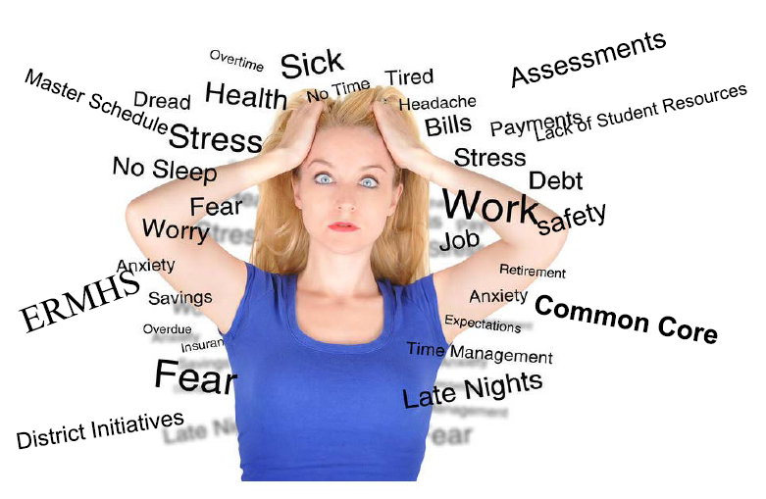
Stress or Trauma?
Notes:
This may be how some of us are feeling now. This is Ok and to be expected!! We need to acknowledge the tremendous stress we are all under. Some days will be better than others but collectively we can move forward in a positive fashion.

Slide 55

Stress: Defined
Positive Stress
  Moderate, short-lived stress responses. Essential for normal development.
Tolerable Stress
  Potentially harmful, but short-lived acute stressors.
Toxic Stress
  Strong, frequent, prolonged activation of stress mechanisms.
Center on the Developing Child (Harvard); National Scientific Council on the Developing Child (2014)
Notes:
Let’s start first with understanding stress.
Positive stress = necessary for normal development. Learning how to deal with stress is actually an important life skill; may have a temporary increase in heart rate and mild elevations in hormone levels
When a young child’s stress response systems are activated within an environment of supportive relationships with adults, these physiological effects are buffered and brought back down to baseline. The result is the development of healthy stress response systems.
Tolerable stress response activates the body’s alert systems to a greater degree as a result of more severe, longer-lasting difficulties, such as the loss of a loved one, a natural disaster, or a frightening injury. If the activation is time-limited and buffered by relationships with adults who help the child adapt, the brain and other organs recover from what might otherwise be damaging effects.
Toxic stress response can occur when a person experiences strong, frequent, and/or prolonged adversity—such as physical or emotional abuse, chronic neglect, caregiver substance abuse or mental illness, exposure to violence, and/or the accumulated burdens of family economic hardship.
In addition, if buffering relationships are unavailable to the child, the result can be damaged, weakened systems and brain architecture,. Thus leading to increased risk for stress-related disease and cognitive impairment, well into the adult years.
When toxic stress response occurs continually, or is triggered by multiple sources, it can have a cumulative toll on an individual’s physical and mental health—for a lifetime.. Research also indicates that supportive, responsive relationships with caring adults as early in life as possible can prevent or reverse the damaging effects of toxic stress response.
COVID-19 is more than likely a tolerable stressor for some but could be toxic stressor for many due to the length of time, particularly for those with preexisting vulnerabilities and risk factors.
Thus, the work we all do and the relationships with foster with our students and colleagues becomes critical to mitigating the negative effects of current life events and stressors.

Slide 56
Acute Trauma
Perceived Threat
Adrenaline & cortisol prepare the body to respond
Body returns to baseline (homeostasis) when threat discontinues
Fight or Flight
  A time-limited (typically tolerable) stressor
      e.g., car accident, natural disaster
In response to an acute stressor the body releases stress hormones that decrease digestive & immune functioning and increase heart rate and blood pressure.
When the threat is gone the body should return to baseline
Cicchetti & Gill (2016)
National Center for PTSD (2016). http://www.ptsd.va.gov/professional/PTSD-overview/complex-ptsd.asp
The National Child Traumatic Stress Network. (n.d.). http://nctsn.org/trauma-types/complex-trauma

Slide 57
Complex Trauma
Perceived Threat
Adrenaline & cortisol prepare the body to respond
Body returns to baseline (homeostasis) when threat discontinues
Fight or Flight
  Complex Trauma (Toxic Stressors)
    Exposure to multiple traumatic events; wide-ranging, long term impact of this exposure.
      e.g., long-term physical/sexual abuse, chronic/ongoing exposure to violence, bias and discrimination
Frequent/long exposure to stress results in the stress response being activated more easily.
Body does not return to baseline as quickly.
Stress hormones negatively effect health, brain development.
Cicchetti & Gill (2016)

Slide 58

Reactions
Physical reactions
Emotional symptoms
Social or interpersonal
Secondary stress/compassion fatigue
Notes:
Physical reactions, such as chronic fatigue and exhaustion are the most frequently reported. Difficulty paying attention, confusion, hypervigilance, headaches, stomachaches, or muscle tension may also be felt. Sleeping and eating may be difficult.
Emotional symptoms can include excessive worry or anxiety, disconnection or numbing, feelings of anger, compassion fatigue, demoralization, or resignation. Recurrent crisis thoughts or distressing dreams and even some confusion and difficulty making everyday decisions can occur. Some people may experience sadness, depression, hopelessness, and/or suicidal thoughts.
Social or interpersonal signs can include difficulties in relationships at home or work, irritability, outbursts of anger, social withdrawal, or isolation. Excessive use of alcohol and other substances can also be warning signs of stress or secondary trauma.
Ways to Watch From Afar
Requirements for physical distancing make identifying and supporting vulnerable staff and colleagues much more challenging. However, there are some strategies that school leaders might find helpful in this regard.
F1) first, if you are aware of a staff member or colleague who was already struggling with mental health challenges or significant stressors before the pandemic, make a point to reach out to them virtually on a regular basis. This provides an opportunity to check in and ask how they are doing and what they are doing to take care of themselves. This also allows for school leaders to begin to gauge how staff members are doing as well as to share information, such as that related to Employee Assistance Programs (EAPs). Loop in your mental health staff, who can reach out and provide additional support and resources.
2) Second, offer regular virtual office hours for staff to “drop in” and connect with you and other colleagues. Consider inviting mental health staff to participate; they may pick up on concerns or issues that staff are struggling with.
Third, provide opportunities for virtual social connectedness for all staff. In addition to checking in and reducing social isolation for those who attend, it allows for identifying those who don’t and who may need a direct check-in.

Slide 59

Pre-COVID-19 School Experience Continuum
Pre-COVID-19 Experiences | Description
Positive | Liked and enjoyed all aspects of school (e.g., academic, extra-curricular, social); felt connected to their school, safe, and cared for as part of a community.
Variable | Liked and enjoyed only particular aspects of school, and either felt neutral or had negative experiences with other elements (e.g., a student who thrived academically, yet experienced bullying or had limited positive social relationships; or a student who loved afterschool sports but struggled academically).
Negative | Disliked most or all aspects of school (e.g., academic, extra-curricular, social); did not feel connected to their school, safe, or cared for as part of a community. However, note that some students may find requirements for physical distancing in the “new” school environment to actually make school less negative (e.g., modifications to recess may minimize negative social interactions).

Slide 60
COVID-19 Shelter in Place Environment Support
Continuum
Degree of Support | Description
Positive | Healthy, safe, nurturing, and adaptive (e.g., most or all needs met, positive experiences with distance learning, no direct financial or health impacts from COVID-19).
Variable | Some supports but also some challenges ; affected by COVID-19 in some areas (e.g., caregivers losing employment; separation from family members, illness of a loved one).
Negative | Unhealthy, unsafe, dangerous, and maladaptive. Reflects either significant impact from physical, medical, or financial COVID-19 related stress (e.g., death of a loved one; loss of home), or living in an environment of child maltreatment, violence, substance abuse and mental health problems, and rejection.
[
https://www.nasponline.org/resources-and-publications/resources-and-podcasts/covid-19-resource-center/return-to-school/returning-to-school-following-covid-19-related-school-closures-the-covid-19-school-adjustment-risk-matrix-(c-sarm)

Slide 61
COVID-19 School Adjustment Risk Matrix (C-SARM)
Brock (2020)

Slide 62
Referrals to outside agencies
Intensive supports in school
Group & Individual Crisis Intervention
Class Meetings
Student Psychoeducational Groups
Psychological Triage
SEL Lessons
Caregiver Trainings
Home visits/check-ins
Staff training trauma-informed care
Tier 2 now may need to be Tier 1
Notes:
Tier 1:
Utilize CASEL SEL Lessons (coming out nationally mid-June) to have psycheducational lessons to discuss the crisis event, dispel rumors, normalize crisis reactions, provide stress management information, and provide information on additional mental health resources. Psychoeducational homework activity could be for students to discuss what they have learned about their ability to cope and/or did they gain a sense of resiliency during this time.
Provide Caregiver training for staff and parents to dispel rumors, normalize crisis reactions, and provide resources for additional supports.
Conduct home visits/check ins for those families that have not been engaged and those who are at-risk for not returning. Want to have a warm opening for them due to issues with mental health, medical concerns, etc.
Have a warm welcome when students and staff return to school. Having fun and exciting activities for staff to complete with students to show how excited they are to have them back. Having special guests like therapy dogs that can visit classrooms to support mental health and mindfulness activities to start the day.
Before schools re-open, create a video for children and families to teach them what to expect. Content topics may include giving reassurance that the children's safety, as they transition back to school, is an MCPS priority; returning to school buildings will require the enforcement of personal distancing in the classroom and outdoors as well as strict hygiene rules (specifics may have to be described at different developmental levels); and adults are working very hard to ensure that all children continue to learn and stay healthy. This situation will get better but we need to be patient and work together.
Training for all staff on trauma informed care and how to create supportive classroom environments.
When schools reopen, set in place a process to identify children and adults who, due to pre-existing conditions or resulting from direct impact to the family during the pandemic, will benefit from mental health support. Determine the level of needed mental health support and working with school based staff arrange for the provision of individual or group support, or make a referral to a community mental health organization.
Tier 2:
Conduct Group and Individual Crisis Interventions to those who have acute traumatic impact to COVID-19 pandemic. Using psychological triage principles, each school can evaluate who is in need of support and who may not need support at all. The Tier 1 supports will be essential since each building will have to utilize the mental health staff that is assigned since all schools will be impacted.
Tier 3:
Make referrals of staff and students to outside partner agencies. Need to develop a referral system of who was referred, who actually started support, monitoring of the support, are there any child find needs.

Slide 63
Strategies to Manage Emotions

Slide 64
Reframing
Defeating Thought
Positive/Empowering Thought
Social Distancing
Shelter-in-place is miserable
Self-care
Students are not learning
We need to expectations
Physical/Spatial Distancing
Others have done it, we can too!
“Career Sustaining Behavior”
We are learning, just in different ways
We need to modify expectations
Notes:
We have been learning, just in different ways. May not be learning academics but learning how to deal with stress (Dr. Bruce Perry)
https://www.psychologytoday.com/us/blog/life-art/202004/covid-19-captivity-and-creative-reframing
The first line of resilience in the face of this reality is to creatively reframe the reality
Reframing the situation from a threat into a challenge.
A threat is something that is happening to you that may hurt you and that you have no control over. A challenge is an obstacle that you can confront, do battle with, and overcome.
Most challenges present opportunities for positive growth. Natural tendency to avoid threats and to pursue challenges.
Challenges are, by their nature, motivating and invigorating!
Research indicates that perceiving stressors as threats activates a maladaptive stress response (including increased heart rate, increased blood pressure, and avoidance orientation),
whereas perceiving them as challenges activates an adaptive physiological stress response (milder increase in heart rate but no increased blood pressure and approach orientation) that is much healthier overall¹.
E.g. = typical threat appraisal of the current situation
Because of COVID-19, I am stuck at home, I can’t do my work, I can’t go to the gym, I can’t go out to dinner, or do any of the activities that give me pleasure. I’ll go crazy stuck at home for another month with the kids with nothing to do.
Challenge reframe: Because of COVID-19 the number of people being exposed to the virus is increasing through social contact. I have an opportunity to help reduce and contribute to the outbreak. My mission is to reduce exposure through social distancing measures and ensuring that my family and I stay positive and practice personal hygiene.
Transforms each individual from a victim of a threatening situation into an agent in control of their circumstances, = lessens anxiety.
If children, this reframing helps them eel they’re part of an important mission rather than being deprived of their former routine, thus they will often rise to the occasion, complain less, and be more cooperative.
Consider others who have endured tight spaces for long periods in order to perform their missions. E.g. astronauts, researchers in the South Pole Station in Antarctica, sailors onboard submarines,
Learn more about people who perform these missions and how they pass the time when they’re not engaged in work. It can make our current “shelter in” situation seem pretty sweet in comparison. Children may enjoy pretending to be on an imaginary mission: playing the part space explorers or Antarctic explorers. Now is also a good time to read more about the explorers of the past who were confined to tight quarters—
All of us are, explorers right now. We are navigating unchartered territories as we use modern technologies and cutting edge knowledge for the first time in history to fight a microscopic enemy. It is indeed a challenge. We are all on a mission and we are active agents in the fight. When we reframe our conception of “shelter in” to be an active piece of a greater quest rather than a threat to our personal routine, we will improve our well-being and be more resilient as we prepare for whatever this battle brings us in the future.
We have been learning, just in different ways
May not be learning academics but learning how to deal with stress (Dr. Bruce Perry)
Modify expectations does not mean lessening expectations
Work “smarter not harder”
Qualification for special education is not the answer!!
Use MTSS to meet the needs and put efforts into delivering intervention, not a lengthy process for qualification

Slide 65
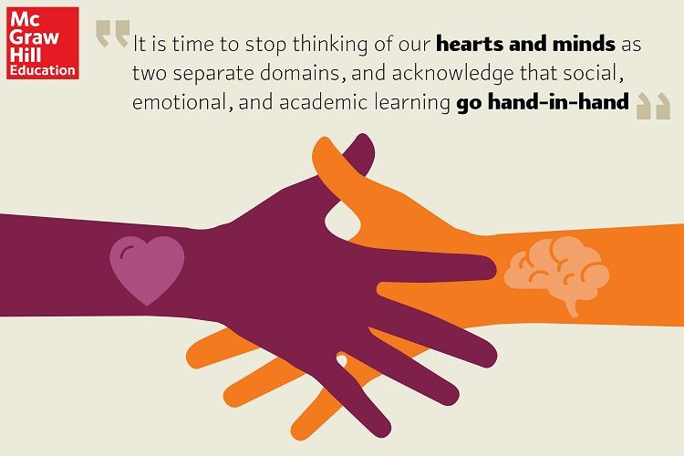

Protective Factors
Developed emotional skills = SEL!!!
Administrator with more developed emotion skills
Notes:
Teachers with more developed emotion skills tend to report less burnout and greater job satisfaction. These skills include the ability to recognize emotions accurately, understand their causes and consequences, label them precisely, express them comfortably and regulate them effectively. But the challenge is that most teachers have not received a formal education in emotion skills.
Second, teachers who work in a school with an administrator with more developed emotion skills tend to experience fewer negative emotions and more positive emotions. These teachers also are likely to have better-quality relationships with their students. When students have stronger connections with their teachers, they, in turn, are more engaged and committed to learning; they’re also more willing to take risks and persist in the face of difficulty.

Slide 66

“Emotions Matter for…”
Attention, memory, learning
Decision making
Relationships
Heath and well-being
Performance
All emotions are ok, is what you do with those emotions.
Yale University (2020) – RULER Approach
Notes:
https://www.edsurge.com/news/2020-04-07-teachers-are-anxious-and-overwhelmed-they-need-sel-now-more-than-ever
Emotions matter for attention, memory and learning. Positive emotions like joy and curiosity increase attention and promote greater engagement. Emotions like anxiety and fear, especially when prolonged, disrupt concentration and interfere with thinking. Chronic stress, especially when poorly managed, can result in the persistent activation of the sympathetic nervous system and the release of stress hormones like cortisol. Prolonged release of this and other neurochemicals impacts brain structures associated with executive functioning and memory, diminishing our ability to be effective educators and undermining student learning.
Emotions matter for decision-making. When we’re overwhelmed and feeling scared and stressed, the areas of our brains responsible for wise decision-making also can become “hijacked.” In contrast, the experience of more positive states like joy and interest tend to help people evaluate individuals, places and events more favorably compared to people experiencing more unpleasant emotions. Pleasant emotions also have been shown to enhance mental flexibility and creativity, which are key to navigating the novel and evolving demands of living through a pandemic.
Emotions matter for relationships. How we feel and how we interpret the feelings of others sends signals for other people to either approach or avoid us. Teachers who express anxiety or frustration (e.g. in their facial expressions, body language, vocal tone or behavior) are likely to alienate students, which can impact students’ sense of safety in the classroom—and likely at home in a virtual learning environment—thereby having a negative influence on learning. Further, dysregulated emotions can undermine healthy relationships between teachers and parents. For most students, a successful distance learning experience will require a solid partnership between teachers and families.
Emotions matter for health and well-being. How we feel influences our bodies, both physically and mentally. Stress is associated with increased levels of cortisol, which has been shown to lead to both physical and mental health challenges, including depression and weight gain. Both the ability to regulate unpleasant emotions and the experience of more pleasant emotions have been shown to have health benefits, including fostering greater resilience during and after traumatic events.
Emotions matter for performance. Chronic stress among teachers is linked to decreases in teacher motivation and engagement, both of which lead to burnout. Teachers who are burnt out have poorer relationships with students and are also less likely to be positive role models for healthy self-regulation—for their students and their families. It’s no surprise that teachers who are burnt out are more likely to leave the profession, which impacts student learning and puts a huge drain on schools.

Slide 67

Student (and Staff) SEL
Self-Awareness
Self-Management
Social Awareness
Relationship Skills
Responsible Decision Making
SEL4US: https://sel4us.org/blog/social-emotional-learning-supports-around-covid-19/
Notes:
https://sel4us.org/blog/social-emotional-learning-supports-around-covid-19/
Self-Awareness
Teach SELF-AWARENESS by encouraging children to talk about and identify their emotions. Reassure them that fears and worries are natural responses in uncertain times and that adults are doing everything they can to help keep them and others safe.
Teach self-confidence: Recognize children’s strengths and reinforce the role they play in having responsible behavior. Express confidence in their ability to seek help or find answers when needed, or to let adults know when others may need help or assistance. Praise children frequently for applying these strengths to help manage their feelings and emotions during the current health crisis.
Teach self-efficacy: Help children feel a sense of control over their circumstances. Explain to them that, while things may seem frightening, there are things they can do to keep themselves and others safe. Talk about the importance of washing their hands frequently with soap and water for at least 20 seconds each time. Discuss the importance of eating healthy and getting plenty of sleep at night.
Self-Management
Teach SELF-MANAGEMENT skills by modeling emotional control and managing daily stresses.
Teach impulse control: Talk about the importance of “thinking before acting.” Discuss situations you may have observed in which the health crisis led to feelings of frustration for people. For example, explain how the crisis led to shortages in some medical and household supplies. Talk about ways in which you observed people managing their impulses to cope with the frustration of not being able to access these supplies. Use other examples as appropriate.
Teach stress management: Discuss how the health crisis has led to many changes for people and some of these changes have resulted in stressful situations. For example, explain how school closings might lead older children to fear that they may not be able to finish their courses for graduation. Use other examples as appropriate. Identify ways in which children might manage their stresses, such as through mindfulness and relaxation strategies.
Teach goal setting: Help children learn to set and achieve goals. Since many schools will be closing, it is important for parents to set and keep a normal routine at home. Goal setting can become a large part of that routine. Help children identify personal and academic goals for the week, then set daily goals and break them into several shorter goals that can be easily achieved. Not only will this strategy help keep them on track with their studies, it will also help keep their minds occupied and off the health crisis.
Teach organizational skills: Since many communities will have reduced access to services and supplies as a result of social distancing efforts, this can be an excellent opportunity to teach preparedness through organizational skills. Explain to children that many people will be remaining at home during this time because community activities and events have been cancelled to ensure everyone’s safety. As a result, families will need to plan for food and supplies they might need while staying home. Turn it into a fun activity such as an adventure or ‘stay’cation. Enlist children’s assistance in planning and organizing the activities and supplies needed for an anticipated 14-day stay at home.
Social Awareness
Teach SOCIAL AWARENESS by modeling empathy and perspective taking. When opportunities are presented, discuss with your children the importance of practicing this in every day and every way.
Teach empathy: Acknowledge and discuss how others might be impacted by the health crisis, social distancing and economic shifts. Talk about how this might feel if it were you or your family. Discuss ways in which your family might help others in need.
Teach perspective-taking, appreciation for diversity and respect for others: Identify how other children and families might respond differently to this crisis. Discuss how some groups and families have different cultures, customs, or beliefs, and while these may be unfamiliar to us, this doesn’t mean they are wrong. Spend time discussing the fact that we are more alike than we are different.
Relationship Skills
Teach RELATIONSHIP SKILLS by demonstrating and discussing ways to improve communications and ways to listen and cooperate with one another. During this crisis, there is a chance that children will be confined at home for an extended period of time due to school closures. Home confinement may result in children having “extra” time on their hands, thus they may become bored or agitated. If there are siblings or other children in the home, there’s an added chance there may be disagreements and conflict. This is an excellent opportunity for parents to model, teach, and reinforce relationship-building skills.
Teach communication skills: Encourage children to communicate their thoughts, feelings, and needs in a non-emotional manner. Teach them to listen to what others say, then if clarification is needed, reflect what they heard using “I heard you say…” statements. Point out when body language and non-verbal expressions might be communicating a different message than their words. Teach children to use “I” statements instead of “You” statements.
Teach cooperation and negotiation skills: When conflicts or problems arise, parents should deal with their own emotions first, then listen to their children, rather than jumping in with a solution. Encourage children to use effective communication skills to resolve problems and conflicts. Explain that negative emotions are a natural experience when having problems and conflict and it is important to learn how to cope with these emotions, especially since the resolution may not always have the desired outcome. Learning to experience and cope with conflict and failure is an important factor in children’s character development.
Responsible Decision-Making
Teach RESPONSIBLE DECISION-MAKING by teaching children how to make constructive choices, especially during this health crisis. Children’s safety is a priority at all times, but the current crisis offers an opportunity to teach them problem-solving strategies, which can reinforce their ability to make appropriate decisions for their own safety.
Teach children problem-solving steps: Children may not always know what the problem really is, so it will be especially important for parents to help them learn how to analyze the situation so they can resolve the problem responsibly. This may include looking at social norms and expectations and evaluating the consequences of their actions. Teenagers, for example, may encounter situations in which they face exposure to the virus as a result of an opportunity to engage in a desired social activity. They must be able to use problem-solving skills to be able to weigh the risks and benefits of their decision, including the possibility of exposing, not just themselves, but also others, as a result of their decision. Parents can help them navigate this process by teaching them the following strategies. Parents may want to employ other examples to help reinforce these problem-solving steps:
Identifying the problem
Analyzing the situation
Identifying a potential solution
Determining the potential consequences of the solution

Slide 68
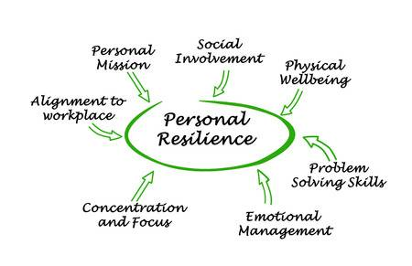
Strategies and Resources
Notes:
There is a lot we can do!!!

Slide 69
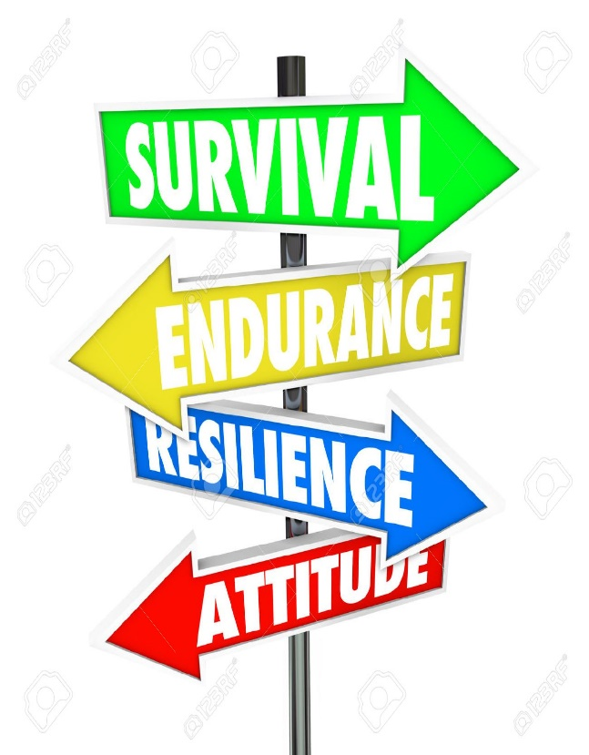
Strengthen internal resiliency
Promote
  active oriented coping styles
  student and staff mental health
  internal locus of control
  self-confidence and self-esteem
Teach
  how to better regulate emotions
  how to accurately identify facial expressions and emotions
Develop problem-solving skills
Foster development of empathy and a strong self-concept
Validate the importance of faith and belief systems
SEL Curriculum!
Notes:
To build internal resiliency we want to do the following: [read slide]
These are the skills that SEL programs and resources can teach and/or enhance.

Slide 70

Build External Resiliency
  Facilitate school connectedness and engagement
  Support staff and families (i.e., provide staff/parent education and appropriate social services)
  Facilitate peer relationships
  Provide access to positive role models
  Ensure connections with pro-social institutions
  Others?
Notes:
Build relationships!!!

Slide 71

Staff
identify new opportunities
Time to connect
Positive psychology!
Help build their capacity to support SEL learning and student SEL
Maximize abilities to connect with students, families, community partners
Access to MH supports
Trauma Informed/Sensitive Schools
Facilitate parent-school-student partnership – ongoing feedback
Collect and act on data regarding students who are disengaged or chronically absent
FUN ACTIVITIES!!!
CASEL 2020
Notes:
CASEL 2020
Allow space for connection, listening, and healing among all leaders and staff in the school building.
This may include carving out time during existing virtual or in-person meetings for staff to process and share their feelings, engage in community-building activities, reflect on how they can use their own social and emotional competencies to support one another and their students, and create individual plans for ongoing self-care.
• Capture this moment to identify new opportunities. Engage staff in reflecting on what they’ve learned from the past few months and how this experience will shape the coming years. Provide time for staff to discuss with one another: How have disruptions to class and school revealed strengths in ourselves and students? What are some new ways to facilitate learning? Where may there be disengagement and inequity?
How can we better partner with families? Offer ongoing opportunities for staff to collaborate on ideas for how to use this learning to inform a collective path forward.
• Provide professional learning to build educators’ capacity to support students’ SEL. This includes professional learning that helps staff build relationships and integrate SEL into in-person and distance learning, create equitable learning environments, identify signs of trauma and mental health concerns, and support grieving students. Free online offerings may provide a starting point over the summer that connects to a longer-term professional learning plan during the school year.
• Maximize staff members’ abilities to connect with students, families, and community partners. For example, consider how staff or community partners can coordinate to check in regularly with a small groups of students and families; how counselors, social workers, school psychologists, and nurses can connect with students and families before schools reopen and during blended or distance learning; and how school staff
can better align with community partners in supporting adults and students.
• Ensure access to mental health and trauma supports for adults. Some adults in the building may be struggling with mental health issues, trauma, secondary traumatic stress, or “compassion fatigue.” Look for signs that adults might need more support and identify available resources. You can use the SAMHSA mental health services locator to search for resources in your community.
Design opportunities for adults to connect, heal, and cultivate their own SEL competencies and capacities.
Engage staff, students, and families in sharing ongoing feedback and partnering on continuous improvement. This may take the form of existing or new school climate surveys, focus groups, phone calls, or other creative strategies. Consider what form of collecting feedback will be most inclusive of all families and students, and whether families and students can help design survey questions or lead focus groups. Feedback questions may include asking about the level of social and emotional support students receive from teachers, staff, or peers; support that staff receive from leadership; student, staff and family needs during distance or blended learning; student and staff emotions throughout the school/work day; and how well staff are communicating with families. After gathering feedback data, continue the conversation through individual or small-group interviews to help contextualize responses and better interpret results. Consider sharing this data
with staff, students, and families and involving them in data reflection and problem-solving.
• Support educators in reflecting on data around their own instructional practices and classroom climate, especially when trying out new strategies or modes of teaching.

Slide 72

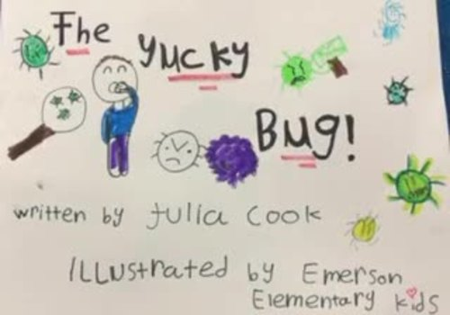
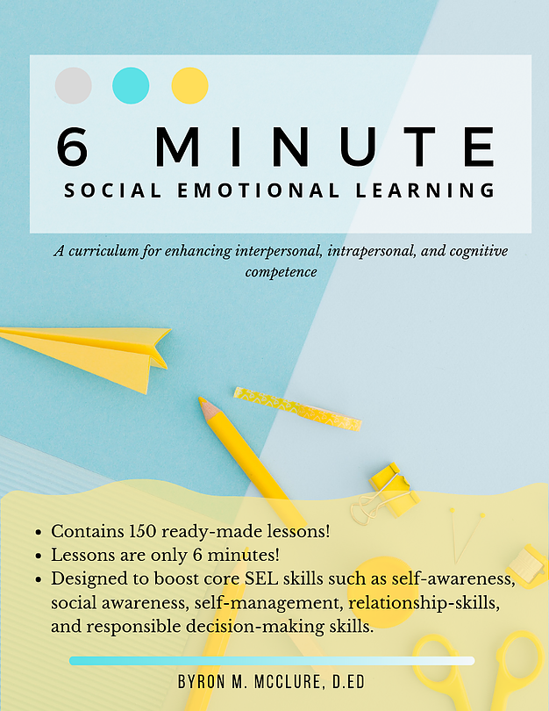
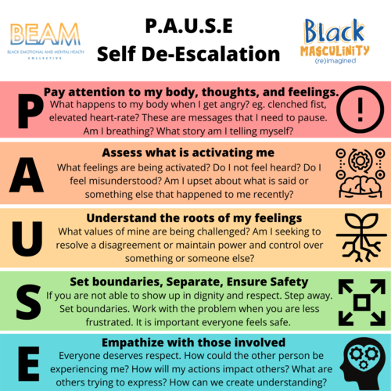
Students – SEL Activities & Resources
https://www.juliacookonline.com/
  YouTube Narration: https://www.youtube.com/watch?v=ZD9KNhmOCV4
https://www.toddparr.com/
6 Minute SEL Lessons
https://www.lessonsforsel.com/
$20 for 150 lessons (digital); $70 hard copy + free video series
Black Emotional and Mental Health (BEAM)
https://www.beam.community/tool-kits-education

Slide 73
Staff & Parents– SEL Activities & Resources
Sacramento Co. Office of Education
  https://www.scoe.net/divisions/administration/communications/coronavirus/resources/wellness/
Kaiser Permanente
  https://thrivingschools.kaiserpermanente.org/resources-for-schools-and-families-impacted-by-covid-19/
West Ed
  https://www.wested.org/covid-19-resources/

Slide 74

Resources
RULER Approach – Yale Child Study Center
  https://www.rulerapproach.org/about/what-is-ruler/
Sesame Street
  www.sesamestreet.org
  https://sesamestreetincommunities.org/
Trauma Informed/Sensitive Schools
  https://traumasensitiveschools.org/
  www,nctsn.org
Notes:
What is RULER? RULER is an approach to social and emotional learning (SEL) that teaches emotional intelligence to people of all ages, with the goal of creating a healthier, more equitable, innovative, and compassionate society.
RULER is an acronym for the five skills of emotional intelligence:
Recognizing emotions in oneself and others
Understanding the causes and consequences of emotions
Labeling emotions with a nuanced vocabulary
Expressing emotions in accordance with cultural norms and social context
Regulating emotions with helpful strategies
four core tools, which are introduced to all stakeholders in the school community—school leaders, teachers, staff, students, and families.
Charter: Builds and sustains positive emotional climates by creating agreed-upon norms for how people want to feel and how they can help each other to experience those feelings.
process of creating an “Emotional Intelligence Charter” with their faculty and staff with positive results.
The process of building a charter or agreement requires us to be vulnerable, and that can be hard, especially in times like these. And some educators are somewhat self-conscious and apprehensive about the process of asking colleagues how they want to feel. It can be scary. Often, how we want to feel is an indicator of what hasn’t been working at our schools. But we’ve found that when schools have the courage to ask, the benefits outweigh the risks.
Specifically, a charter reflects the agreed-upon feelings and behaviors of the members of a learning community. Here, we describe the process of building a faculty and staff charter. The same process can be applied to the classroom or home environment.
It starts with a deceptively simple question: How do we want to feel as a faculty/staff? A principal or group of teachers can pose the question to the faculty and staff at their school. Once everyone shares their top three or four hoped-for feelings, the goal is to narrow them all down to a “top five” list reflective of the entire faculty.
The second question is: What do we need to do for everyone to feel this way? Here, faculty and staff share specific ideas that would support them in experiencing each of the feelings. The goal is to come up with two or three observable behaviors that are realistic and attainable for each feeling. For example, in order for teachers to feel supported around distance learning, what exactly will everyone agree to do differently so everyone feels supported? If teachers want to feel more valued, what are the specific things schools can do? Perhaps everyone can agree to respond to virtual inquiries in a timely manner.
Once the five feelings and related behaviors are compiled, the charter can be created and distributed to each member of the faculty and staff. In this virtual world of education, be creative about ways to disseminate it to everyone. If your school or district uses a learning management system, perhaps the charter can be “public” there.
Importantly, the charter should be a living document—it will evolve as your learning community does throughout the pandemic. Consider weekly reflections and opportunities for teachers to share ideas based on their hoped-for feelings. For example, if teachers want to feel more engaged, perhaps create opportunities for them to share their best virtual lesson of the week and why it worked so well.
Mood Meter: Enhances self- and social awareness and supports the development of a nuanced emotion vocabulary and a range of strategies for regulating emotion.
Meta-Moment: Provides a process for responding to emotional situations with strategies that align with one’s best-self and that support healthy relationships and personal well-being.
Blueprint: Supports the development of empathy and conflict resolution skills by serving as a guide for reflecting on conflict and restoring affected communities.

Slide 75
Resources
CASEL
  www.casel.org
  https://casel.org/wp-content/uploads/2020/05/CASEL_Leveraging-SEL-as-You-Prepare-to-Reopen-and-Renew.pdf
NASP/ASCA
  https://www.schoolcounselor.org/school-counselors/professional-development/learn-more/school-re-entry
  https://www.nasponline.org/resources-and-publications/resources-and-podcasts/diversity/social-justice

Slide 76
Resources
School Reentry Considerations Supporting Student Social and Emotional Learning and Mental and Behavioral Health Amidst COVID-19:
    https://www.nasponline.org/resources-and-publications/resources-and-podcasts/covid-19-resource-center/crisis-and-mental-health-resources (scroll down the page to find)
NASP - “Ask the Expert Webinar Series”
    https://www.nasponline.org/covid-19-webinar-series
Best Practices in Universal Screening
    https://smhcollaborative.org/universalscreening/
SAEBRS: Social, Academic, Emotional and Behavioral Risk Screener
    https://www.fastbridge.org/saebrs/
Incredible Years
    http://www.incredibleyears.com/

Slide 77
Resources
NASP COVID-19 Resource Center
  https://www.nasponline.org/resources-and-publications/resources-and-podcasts/covid-19-resource-center
Care for the Caregiver: Guidelines for Administrators and Crisis Teams
  https://www.nasponline.org/resources-and-publications/resources-and-podcasts/school-climate-safety-and-crisis/mental-health-resources/care-for-caregivers-tips-for-families-and-educators/care-for-the-caregiver-guidelines-for-administrators-and-crisis-teams
Self-Care Lessons From the Field
https://www.nasponline.org/professional-development/a-closer-look/self-care-lessons-from-the-field
Self-Care for School Psychologists
https://www.nasponline.org/resources-and-publications/resources-and-podcasts/mental-health/self-care-for-school-psychologists

Slide 78

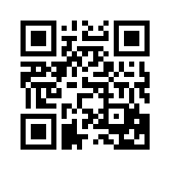
PREPaRE Crisis Prevention & Intervention Curriculum
Workshop Descriptions & Target Audiences
Program Evaluation Data
Upcoming Trainings
List of Local Trainers
FAQs
http://www.nasponline.org/prepare/index.aspx

Slide 79
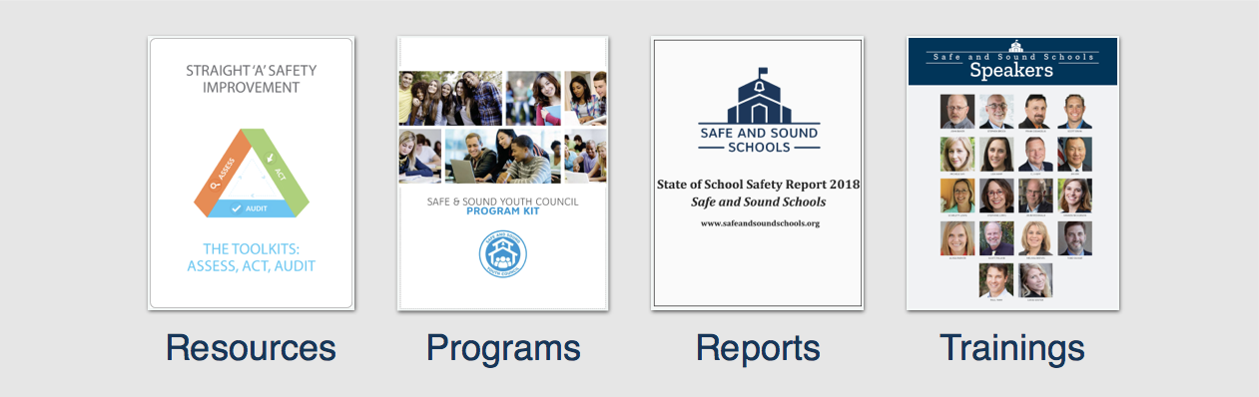
Safe and Sound Schools
www.safeandsoundschools.org

Slide 80
Threat Assessment
Considerations in the Virtual Environment

Slide 81
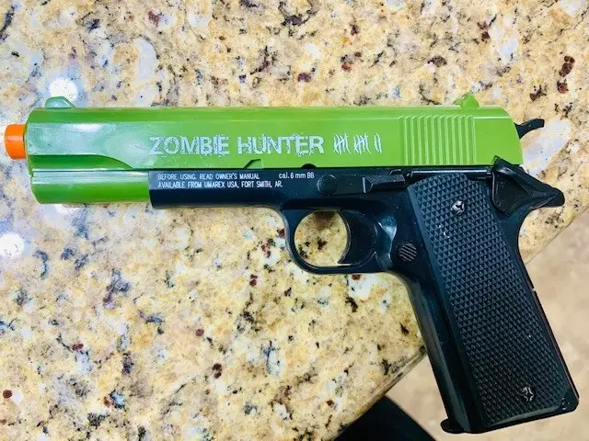
https://www.buzzfeednews.com/article/ellievhall/black-student-suspended-toy-gun-virtual-class
Notes:
A Colorado school suspended a 12-year-old boy for five days and sent the police to his home after a teacher saw him “waving” a toy gun during a virtual class.
Isaiah Elliott, a seventh-grader at Grand Mountain School in Colorado Springs, was attending an art class via distance learning on Aug. 27, his third day of school. His mother, Dani Elliott, told BuzzFeed News that at one point during the lesson, her son picked up a neon green toy gun and moved it from one side of his computer screen to the other.
lliott said Isaiah often has trouble concentrating during classes because he has attention-deficit/hyperactivity disorder (ADHD). She said the school “had been made well aware” of her son’s ADHD diagnosis and that Isaiah has an IEP (Individualized Education Program) plan on file.
After the class concluded, Elliott said she received an email from her son’s art teacher saying that Isaiah had been “extremely distracted” during the lesson.
The teacher wrote that there had been “a very serious issue with waving around a toy gun,” which she had reported to the school’s vice principal, according to Elliott.
Soon after getting the email, Elliott said she received a call from Grand Mountain School vice principal Keri Lindaman informing her that she had called school resource officers from the El Paso County Sheriff's Office to conduct a health and wellness check on Isaiah at the family's home.
“I had already explained to the teacher that it was a toy,” Elliott said. “I told [Lindaman] that it was a toy. She admitted that she knew it was a toy but Isaiah’s safety was of the utmost importance.”
Elliott said she couldn’t believe that the school administration had escalated the situation without informing her or her husband.
“An hour and a half after receiving [the teacher’s] email, I found out that the police were on their way,” she said.
According to a redacted copy of the incident report obtained by KOAA News, the teacher told Lindaman “she assumed it was a toy gun but was not certain.”
At the time, one of her son’s classmates was also at their home for virtual lessons.
After the vice principal’s call, Elliott said she told her husband, Curtis Elliott, who had briefly left their home, to “turn around and go straight home.”
“I had to logically think out, How do I protect my son? What do I have him do [when] playing with a toy in the privacy of your own home is a threat?" Elliott said.
When the El Paso County Sheriff’s officers arrived at the family home, they showed her husband footage from the incident that they had seen in the vice principal’s office and that was recorded on their body cameras.
Elliott said she had not seen the video because the school has so far refused to release it to her — but told BuzzFeed News that she was unaware that the school had been recording the virtual classes without informing parents, and that she never would have consented if she had known.
However, she said both her husband and Lindaman told her that the only thing Isaiah did was pick up the toy gun from the couch and move it from one side of the screen to the other.
In a statement posted to Facebook on Thursday, Grand Mountain School said there were “several inaccuracies being spread on social media” about “an incident that took place during distance learning" but declined to provide details, citing privacy laws.
"We never have or ever will condone any form of racism or discrimination," the statement said. "Safety will always be number one for our students and staff."
The school said it was not "our current practice" to record classes, but added that its distance learning platform had a feature to record classes.
"During our first week of school, we were still becoming familiar with the platform," the school said.
Isaiah’s official notice of suspension, which Elliott provided to BuzzFeed News, said that he was guilty of “violation of district or building policies or procedures” and “behavior on or off school property which is detrimental to the welfare, safety, or morals of other pupils or school personnel.”
“Isaiah displayed and waved a firearm facsimile during a virtual classroom on Aug. 27, 2020,” the document said.
Even though the incident occurred at their home, Elliott said the suspension notice was written in a way that made it sound like Isaiah had brought the toy gun to school and had disrupted his class.
“This could potentially impact his future... Look at everything that’s going on in the world today,” Eliott said. “God forbid something happens to my son down the road, people could look at this and decide he doesn’t deserve justice. I know that sounds extreme... It’s a very real reality for us.”
Elliott said she feared law enforcement officials arriving at their house for her son because Isaiah was the same age as Tamir Rice, who was shot dead by police in 2014 while playing with a toy gun in a park across from his family home.
“Parents of African American children go above and beyond to protect our children and ensure their future,” she said. “Until you’ve lived this life, until you’ve experienced discrimination and hardships that come along with being born a certain skin color… I thank God that it didn’t go another way and my son is still here with me."
Although Isaiah’s suspension ended on Friday, Elliott said she “has no intention of him going back” and will formally withdraw him from the school on Tuesday. She said he is currently on the waiting list at a charter school, and she has reached out to child education advocacy groups for resources to help Isaiah continue to learn at home.
“Having toys in my house is something I thought I never had to think of,” she said. “It never crossed my mind that toys could be seen as a threat.”

Slide 82
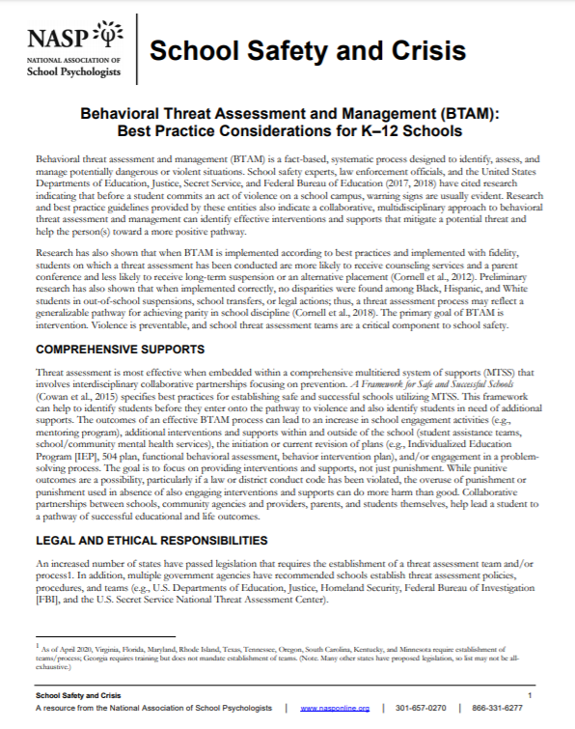
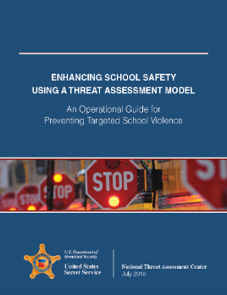
Behavioral Threat Assessment & Management (BTAM)
Building a School Threat Assessment Program:
    Step 1: Establish a multidisciplinary team
    Step 2: Define prohibited and concerning behaviors
    Step 3: Create a central reporting mechanism
    Step 4: Define threshold for law enforcement intervention
    Step 5: Establish threat assessment procedures
    Step 6: Develop risk management options
    Step 7: Create and promote safe school climates
    Step 8: Conduct training for all stakeholders
Notes:
Instructor Notes
Next we are going to talk about steps to building a school threat assessment program.
All of the information in this section is covered in two resources:
Enhancing School Safety Using a Threat Assessment Model (published by the US Secret Service in 2018)
And for guidance on running a threat assessment program in a virtual environment:
NASP School Safety and Crisis Response Committee. (2020). Behavior Threat Assessment and Management in the Virtual Environment. [handout]. Bethesda, MD: National Association of School Psychologists.

Slide 83
Proacative BTAM Efforts in a Virtual Environment
    **State laws must still be followed.**
    Provide direct instruction on acceptable and prohibited behaviors in a virtual environment
    Report concerning and prohibited behaviors using to BTAM team
    Use school psychologists, social workers, and counselors to provide mini social-emotional learning (SEL) lessons as part of regular online class time.
https://www.nasponline.org/resources-and-publications/resources-and-podcasts/covid-19-resource-center/crisis-and-mental-health-resources/behavior-threat-assessment-and-management-in-the-virtual-environment
Notes:
Instructor Notes
For all 3 slides on Operating in a Virtual Environment, please tell participants that all of these tips come from a document recently published by the National Association of School Psychologists (NASP) on how to build and operate a threat assessment team in a virtual environment. The NASP document is part of the handouts in participants’ handouts locker.
For this slide, emphasize the following:
Texas law (SB 11) still applies even if schools are closed. Texas schools are still expected to build and operate their threat assessment teams and will have to report on their progress beginning in November 2019 (Brit will elaborate on the Data Collection slide)
You can still work cases and run meetings. Try to secure a conference line or video conferencing account.
Remind everyone in the school community that the team is still operating and provide some guidance on what to report.

Slide 84
Operating Threat Assessment Teams in a Virtual Environment
    BTAM Teams
    Continue to follow BTAM process.
    Interviews and team discussions can be conducted in a virtual environment,
      Identify a secure video conferencing platform.
    Determine how to access educational records and other data.
    Document efforts attempted to access information and limitations encountered
    Update law enforcement contact information
      SROs may be assigned other duties during school closures.
    Consider adding essential community members who can provide supports and follow up.
Notes:
Instructor Notes
For all 3 slides on Operating in a Virtual Environment, please tell participants that all of these tips come from a document recently published by the National Association of School Psychologists (NASP) on how to build and operate a threat assessment team in a virtual environment. The NASP document is part of the handouts in participants’ handouts locker.
For this slide, emphasize the following:
Make sure you know who your law enforcement contact is. SROs may be reassigned other duties within their department when schools are closed.
You can still conduct interviews; video conferencing is preferable to phone if available.
Check to see how you can access education records – can you access them remotely or need physical access?
Involve your school psychologists and counselors to lead mini-lessons on social-emotional learning. Gives teachers a break and helps promote social-emotional skills

Slide 85
Intervention & Management in a Virtual Environment
  Daily virtual check-ins with student of concern and/or parents
      school psychologists, social workers, and counselors, mentor, coach, other community member
  Monitoring school email and Internet activity (on school devices)
  Teachers monitoring schoolwork and chats with classmates
  Guidance for parents on how to monitor, what to look for
  Connecting parents with support resources if needed
  Reduced social media presence for targets
  Involve law enforcement for home visits
  App-based support for depression, anxiety, and to build resiliency
Notes:
Instructor Notes
For all 3 slides on Operating in a Virtual Environment, please tell participants that all of these tips come from a document recently published by the National Association of School Psychologists (NASP) on how to build and operate a threat assessment team in a virtual environment. The NASP document is part of the handouts in participants’ handouts locker.
For this slide, emphasize the following:
Emphasize the case management or intervention is going to look different than when schools are open.
Case management will need to involve family members, informal check-ins, and involving local law enforcement for home visits / welfare checks if needed.

Slide 86
Threat Assessment Resources
Protecting America’s Schools. A U.S. Secret Service Analysis of Targeted School Violence (2019)
  https://www.secretservice.gov/protection/ntac/
Enhancing School Safety Using a Threat Assessment Model: An Operational Guide for Preventing Targeted School Violence (2018)
  https://www.dhs.gov/sites/default/files/publications/18_0711_USSS_NTACEnhancing-School-Safety-Guide.pdf
Making Prevention a Reality: Identifying, Assessing & Managing the Threat of Targeted Attacks (2017)
  www.fbi.gov/file-repository/making-prevention-a-reality.pdf
Reeves, M.A. & Brock, S.B. (2017). School Behavioral Threat Assessment and Management. Journal of Contemporary School Psychology, 1-15. Doi: 10.1007/s40688-017-0158-6.
  http://link.springer.com/article/10.1007/s40688-017-0158-6
School Resource Officers, School Law Enforcement Units, and Family Educational Rights and Privacy Act (FERPA). (2019)
    https://studentprivacy.ed.gov/sites/default/files/resource_document/file/SRO_FAQs_2-5-19_0.pdf
NASP COVID-19 & Virtual Resources
  https://www.nasponline.org/resources-and-publications/resources-and-podcasts/covid-19-resource-center/crisis-and-mental-health-resources/behavior-threat-assessment-and-management-in-the-virtual-environment

Slide 87
IT IS POSSIBLE TO PREPARE FOR THE FUTURE WITHOUT KNOWING WHAT IT WILL BE.
THE PRIMARY WAY TO PREPARE FOR THE UNKNOWN IS TO ATTEND TO THE QUALITY OF OUR RELATIONSHIPS,
TO HOW WELL WE KNOW AND TRUST
ONE ANOTHER.
MARGARET WHEATLEY | 2004

Slide 88


Melissa A. Reeves, Ph.D., NCSP, LCMHC
School Psychologist
Licensed Clinical Mental Health Counselor
License Special Education Teacher
Associate Professor, Winthrop University, SC
drmelissareeves@gmail.com or reevesm@winthrop.edu
@melissareevessp
https://www.linkedin.com/in/melissa-a-louvar-reeves-388b97bb/

Slide 89
Integrating Tiered Supports For Promoting Mental Wellbeing
Don Kincaid
Florida’s PBIS Project
This presentation was developed in part under grant number 5H79SM061890 from the Substance Abuse and Mental Health Services Administration (SAMHSA), U.S. Department of Health and Human Services (HHS). The views, policies, and opinions expressed are those of the authors and do not necessarily reflect those of SAMHSA or HHS.
Notes:
CR Welcome and Mention handouts in File Share (or remove if we add site location). Before we begin most of our content included in this webinar was provided and structure with the assumption that listeners are using their PBIS muti-tiered framework as a foundation for the enhancement work we discuss and also to note that we are utilizing resources/implementation examples from AWARE technical assistance and pilot work from 3 Florida districts on this topic.

Slide 90
Goals For Today
Understanding the Need
Define Complete Mental Health
Review how critical features of PBIS Framework promote complete MH
Provide resources and identify enhancements to PBIS framework to support promotion of MH

Slide 91
Description of the Problem
Approximately one in five students has a diagnosable disorder and most do not access the supports they need; Even more youth are languishing in life… not yet symptomatic, but report low well-being
Bradshaw, Buckley, & Ialongo, 2008; Costello et al., 2003; Costello, Egger, & Angold, 2005; Merikangas et al., 2010; Suldo & Shaffer, 2008
Despite schools being the most likely setting for a youth to access mental health supports and mental health being a precondition for learning, schools lack systems for providing comprehensive, coordinated social and emotional supports
Adelman & Taylor, 2008; Farmer & Farmer, 1999; Rones & Hoagwood, 2000
Notes:
NR When looking at current youth needs in regard to mental health these are two BIG Ideas driving the case for systems change towards effective school-based mental health supports, and provides an essential why for enhancing your PBIS framework for Mental Wellness. The prevalence of need supports the use of a prevention framework like PBIS and the direct connection to readiness to learn is part of the why for schools being an ideal setting to address mental wellness although it has been cited in several studies they may not be ready to do this with current systems in place.

Slide 92
The Need is Largely Unmet
Approximately half of the students with a mental health disorder will not receive treatment
Youth with behavior disorders:
Only 45–60 % of received clinical services
Youth with an anxiety disorder or any mood disorder:
Only 18 and 38% of respectively, received any mental health treatment for their diagnosis
Among those who get care in community, persistence is poor (3-4 contacts)
- Merikangas, et al., 2011
Notes:
In addition to the last two big ideas, Approximately half of the students meeting diagnostic criteria for a mental health disorder will not receive treatment for such (Merikangas et al.: A nationally representative study of 10,000 adolescents (ages 13–18) found that approximately 14 and 32 % had a mood or anxiety disorder, respectively, at some point during youth
(Merikangas et al., 2010). Whereas 45–60 % of youth with behavior disorders received clinical services, only 18 and 38 %of youth with an anxiety disorder or anymood disorder, respectively, received any mental health treatment for their diagnosis (Merikangas, et al., 2011).
Merikangas et al. (2011) found that youth with internalizing disorders are even underrepresented in SMH care, which is particularly unfortunate given that a recent meta-analysis of 63 studies (N = 15,211) supports that both depression and anxiety disorders can be treated in schools effectively using cognitive–behavioral interventions traditionally delivered in clinical or research settings (Mychailyszyn, Brodman, Read,&Kendall, 2012).
Students with internalizing disorders are common, but underserved in community and school because they do not disrupt class or violate school rules, and many may not have obvious outward displays of symptoms. A nationally representative study of 10,000 youth (ages 13 to 18) found that approximately 14% and 32% had a mood or anxiety disorder, respectively, at some point during youth (rates of anxiety were stable and high, whereas depression was most evident among the high school years; Merikangas et al., 2010).
AS a summary of these points for district and school implementers: Research consistently demonstrates that students with internalizing issues (anxiety, depression, etc.) are under identified and less likely to access the supports they need. Schools traditionally have focused on externalizing behavioral problems.

Slide 93
Goals of Mental Health Services
Traditional approach
Remediate social, emotional, or behavioral disturbances among referred students
Public Health Approach
Promote psychological well-being of all youth
Promote healthy caretaking environments (classroom, school, home, community), which help youth overcome risk and challenges
Provide protective support to youth at elevated risk for academic and emotional problems
Remediate social, emotional, or behavioral disturbances among referred students
Goal: Foster the social, emotional, behavioral, and academic competence that students need to be successful in school and in life
(Doll, Cummings, & Chapla, 2014)
Notes:
NR Traditional mental health services involve caring for those youth with apparent problems, youth who commonly come to the attention of a mental health service provider following referral from a concerned educator or parent. Or from the last slide focus on correcting weakness.
In a public health approach such a multi-tiered approach (as listeners may be familiar with in other content areas such as reading), population-based mental health services include carefully planned efforts that meet the collective mental health needs of all students in a given school. Services start with universal assessment of students’ mental health, and planning an array of services across the tiers to promote psychological wellness as well as reduce symptoms and subsequent onset of problems that are most apparent in that school. Similar to reading screening and focus on Tier 1 quality instruction and curriculum.
A public health approach is supported by the sheer prevalence of mental health problems among youth mentioned in an earlier slide. And students’ psychological wellness is essential for positive functioning later in life as well as their current and later academic success.
Only as the field has matured has it begun to respond to intensifying interest and concerns about disease prevention and health promotion. Because of the more recent consideration of these topic areas, the body of accumulated knowledge regarding them is not as expansive as that for mental illness”

Slide 94
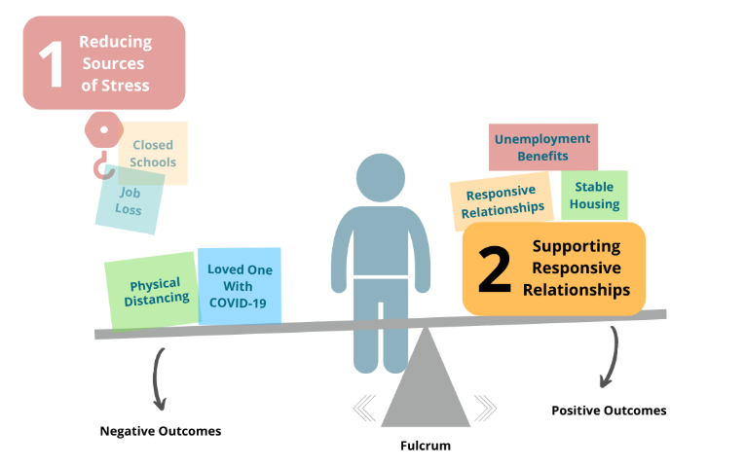
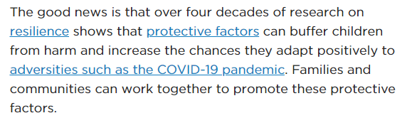
Effects of The Pandemic And Supporting Resilience
https://www.childtrends.org/publications/ways-to-promote-childrens-resilience-to-the-covid-19-pandemic

Slide 95
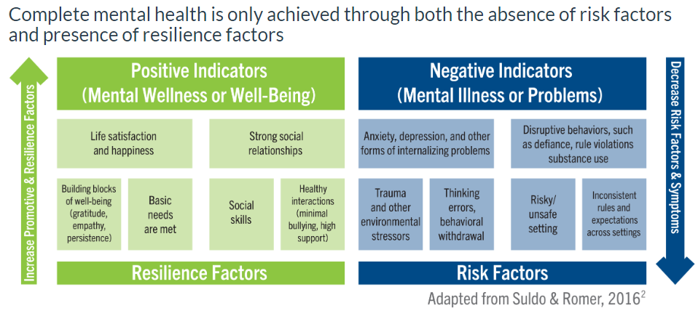
Students with complete mental health have better outcomes academically, socially and with physical health than those with only absence of problems.
Smith, Suldo, Hearon, & Ferron, 2019-Suldo, Thalji-Raitano, Kiefer, & Ferron, 2016, Suldo & Shaffer, 2008)

Slide 96
Why schools?
Opportunities for generalization and maintenance
Mental health is a precondition for learning
Reduced stigma associated with increased awareness and high quality intervention
Accessibility of care for youth and their families
Universal supports and instruction
(Adelman & Taylor, 1998; Doll & Cummings, 2008; Knoff, 2007; Stephan, Weist, Katoaka, Adelsheim, & Mills, 2007,
Suldo, Gormley, & DuPaul, 2014)
Notes:
NR
There is often philosophical questions and debates around why we should focus on social emotional skills, and mental health in schools as a setting versus more clinical settings. In addition to what has been reviewed in the last couple of slides, these points summarize some of the primary reasons why school are the most ideal place for access, especially in those schools implementing the PBIS Framework that have established systems for universal behavioral instruction/prevention that promotes generalization of skills into students educational career and adulthood. Integrating mental health interventions within this framework helps reduce the stigma that may reduce access to supports within and outside of schools.

Slide 97
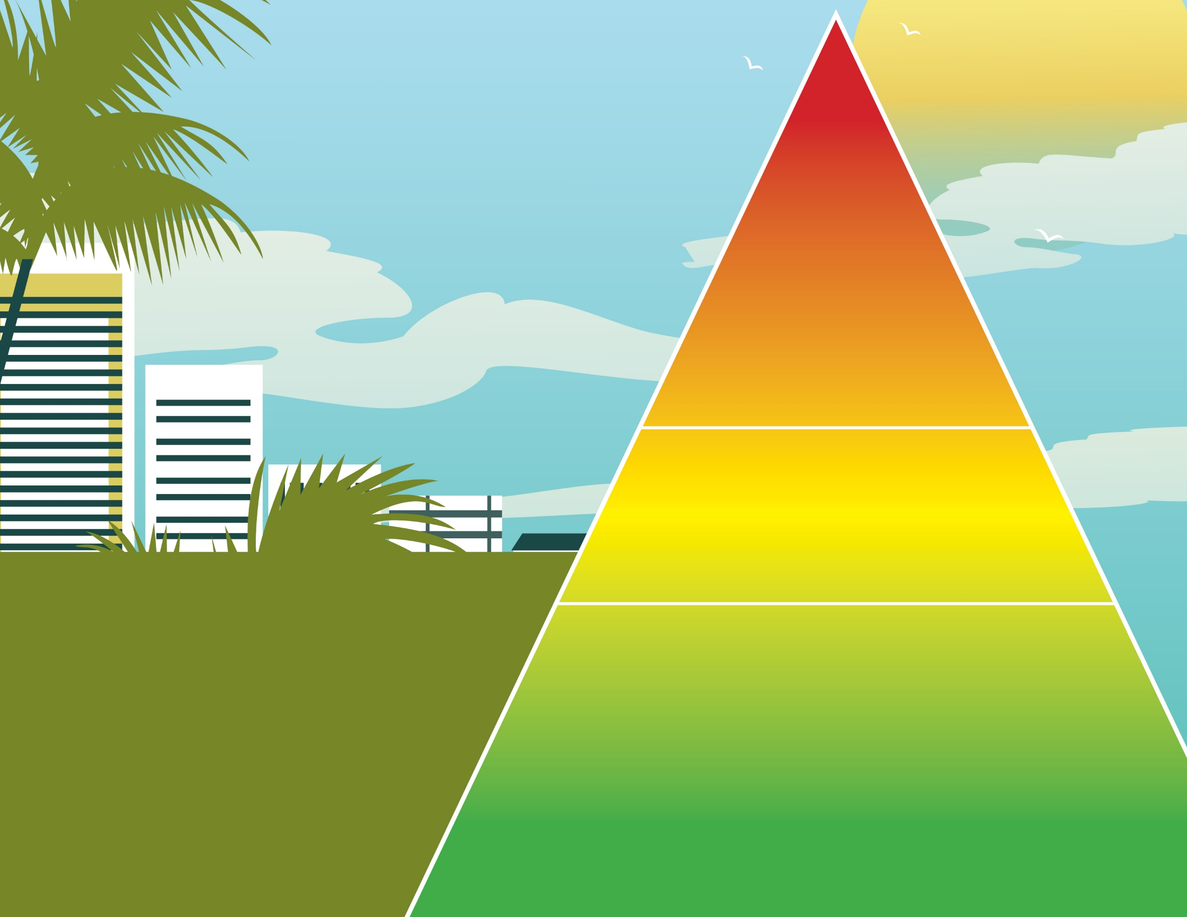
Florida’s System of Supports for School-Based Mental Health Services
^{TIER 3}
^{Individualized}
^{Intensive}
Decision-rules & referral-
follow-up procedures
Data and strategy sharing between
school and agency staff
Individualized counseling/ intervention,
behavior support plans
Intensive progress monitoring
Wrap around & crisis planning
Intensified family partnership and communication
TIER 2
^{Supplemental/At-Risk}
Decision rules for early identification and access
Evidence-based group social, emotional, &behavioral interventions based on need
Monitoring of intervention fidelity and student progress
^{FOUNDATION}
^{a.} Integrated Leadership Teams – expand teams and roles
^{b. Effective data systems}
c. Strong Universal implementation
^{d. Continuum of supports}
e. Youth-Family-School-Community Collaboration at All Levels –
^{culturally responsive}
f. Evidence-base practices at all levels
g. Data-based continuous improvement
h. Staff Mental Health Attitudes, Competencies, and Wellness
i. Professional development and implementation support
j. Policy changes that protect confidentiality but promote
mental health collaboration and flexibility
TIER 1
^{Universal Prevention}
Universal screening and progress monitoring; Needs assessment and resource mapping;
Reduced Risk Factors - Create orderly and nurturing classrooms and public space; fair and positive discipline, curtailed bullying; Increased Protective Factors - Social-emotional skills instruction, positive/secure relationships, predictable environment; Restorative and Trauma Informed Practices; Data-based problem solving leadership teams that include youth serving agency, youth and family; School-wide mental wellness initiatives to increase awareness and reduce stigma; Youth Mental Health First Aid Training, Wellness Fairs, Behavioral Health Campaigns
Notes:
CR –The visual is part of that guidance and illustrates features of a multi tiered system that integrates elements of the 6 critical compOur state recently provided some guidance as part of SB7026 on mental health tiered supports. onents of just viewed in the Hexagon, we will also dive a little deeper into some of these practices. It is also a nice connection that the foundation relies on several features that will be familiar and hopefully established as part of PBIS framework such as leadership team and school wide practices that support orderly and nurturing classrooms, positive relationships and predictable environments
FL System of Supports
Level of support based on student need (includes prevention and intervention)
Schoolwide preventive services – fostering positive & healthy school environments (All students)
Supplemental interventions & supports – targeted targeted groups (Some students)
Intensive, individual interventions (Few students)
Data-based problem-solving
Monitor the effectiveness of intervention/support & modifying as needed

Slide 98
Universal Level Prevention/Promotion of Mental Health Examples (Tier 1)
Features | Examples
Focus: Prevention and competence-building for all students. Define and teach appropriate social behaviors. | Social Emotional Learning (SEL) curricula & School-Wide PBIS
 | Positive Psychology well-being promotion
Use schoolwide data for: needs assessment, screen all children for emerging problems (internalizing and externalizing), and monitor progress of universal services | Resilient Classrooms
 | School Climate initiatives
 | Universal screenings
Schoolwide development and generalization of specific skills (e.g., social skills, responding to bullying) | School-Wide Positive Behavior Interventions and Support
 | Social Skills curricula,
Schoolwide practice of such specific skills | Violence/bullying prevention (e.g., Olweus Bullying Prevention Program, Peacebuilders)
Provide direction, instruction AND adult/peer modeling of skills taught
- Christner & Mennuti, 2009; Simon, 2016
Notes:
CR: To help with think through current PBIS implementation and what gaps may be present, this is a nice summary of Universal/Tier 1 Promotion of Mental Wellness.
Goal of universal mental health intervention:
Goal of increasing social and emotional competence and decrease risk for emotional, behavioral, and learning difficulties
Goals of universal interventions:
Build protective factors in order to reduce vulnerability for future problems or maladaptive ways of coping
Prevent problems for students before they occur
Offer global resources to students who are at risk or those who have existing vulnerabilities
School-wide Positive Behavior Supports
Bullying Prevention
Evidenced-based practices to improve student engagement
Improving school climate and ensuring a process for students to report potentially harmful behaviors
Identify students in need of mental health needs:
Universal screenings for behavioral and mental health issues
Early identification of risk factors that lead to mental health concerns
Training for school staff and parents on risk factors that lead to mental health concerns
Direct instruction in Social-Emotional Learning (SEL) skills

Slide 99
Universal MH Promotion Tier 1 Goal: Enhance protective factors for entire school population to reduce risk
Social Emotional Learning
Positive Psychology
School Climate: PBIS, Teacher and Staff Wellness, Family and School Collaboration
Reassure by promoting safety and routines
Self-Regulation Of Difficult Emotions
Strength Based
Trauma Informed Practices
Reducing Stressors: Resource Fairs, Meeting Basic Needs

Slide 100
Purpose of Positive Behavior Intervention Supports
…to make schools more effective and equitable learning environments for ALL students.
Predictable
Positive
Equitable
Framework for Student Supports
Consistent
Safe
Trauma Responsive
Notes:
PBIS is a framework that supports installation of any initiative and ensures data, systems and practices.
The purpose and evidence of outcomes of implementing PBIS with fidelity demonstrates creating predictable, consistent, positive, safe and equitable environments for students.
While there are many definitions or frameworks for being trauma informed, most would include these components. The next slides crosswalk one definition provided by National Childhood Trauma Stress Network’s (NCTSN) of trauma informed with the outcomes/purpose of PBIS.

Slide 101
Teaching Behavior Through PBIS…
The ‘Why’
Reduces Reactionary Practices
Creates a safe, nurturing environment
Promotes mental wellness
Enhances academic success
Promotes Attendance
Builds Positive Relationships
Builds On Family & Students’ Cultural Expectations
What do they bring to school?
  Strengths and assets
  Historic educational expectations & experiences
  Values, beliefs, & traditions
  Views about behavior
  Motivators and reinforcers
Smith-Evans, L., Leverson, M. & Smith, K. (n.d.). Culturally Relevant Practices & PBIS. http://www.wisconsinpbisnetwork.org/
Notes:
Rationale: The flip side, what we gain when we DO teach behavior. More likely to recognize & tap into student strengths, association with improved outcomes.
More about the “Why”….
Green Box: Family & Students’ Cultural Expectations Box –Make connections with the “safe” diversity reflection activity we did in the introduction (values when young, now, school’s values). This is included as a reminder of the need to look at students/families’ cultures when moving forward to determine what and how to teach behavior.
Edit for readability: Promotes social-emotional skills that foster mental wellness became “Promotes mental wellness”

Slide 102
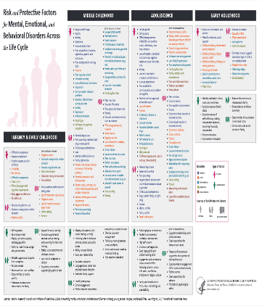
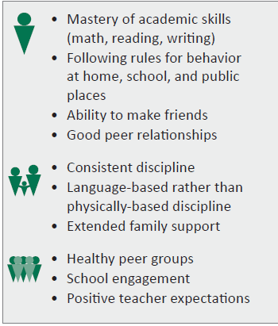
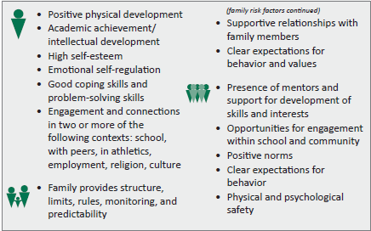
Mental Health Protective Factors
MIDDLE CHILDHOOD
ADOLESCENCE
Source: National Research Council and Institute of Medicine. (2009). Preventing mental, emotional, and behavioral disorders among young people: Progress and possibilities. Washington, DC: The National Academies Press.
Notes:
Rationale: Expectations should also be broad enough to address mental & physical health, and we know that the development of positive behavioral expectations within schools promotes mental wellbeing for students . The handout (tiny print version available in other resources section of this module within canvas) identifies protective and risk factors for some of the most prevalent mental health disorders across individuals at the top, families in the middle and schools within the red boxes across the developmental lifespan. The slide only provides examples of factors that are protective against developing mental health concerns. The factors inside the red boxes (which appear automatically) are those that highlight things schools can do to foster mental wellbeing. Click to bring up the red arrows…they point to really obvious connections between mental wellness & SWE. The development of a core behavioral instruction system as mentioned about why we teach behavior also promotes mental wellbeing through the teaching individuals skills, for example for middle childhood or school age youth those skills that promote strong friendship skills and good coping skills and emotional management for adolescents.
When schools are considering their common language in what they will teach for school wide expectations, this would be a strong consideration along with sharing with family and student stakeholders in continuing development. These factors when present protect youth from progressive problems that would become to the severity of a mental health disorder.

Slide 103
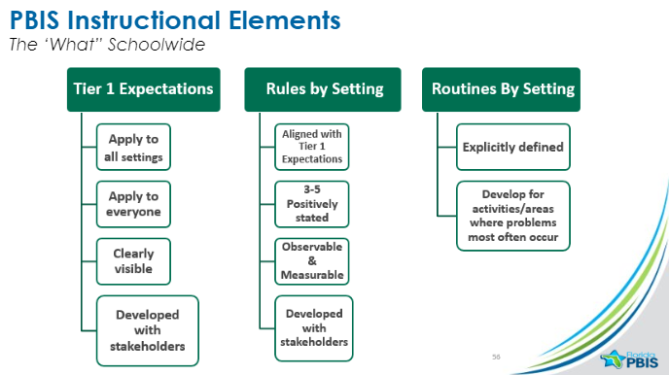
TI Practice: Build Safe and Predictable Environments
Foundation for Relationships
School Teams Can Promote MH Through Integration of Additional Social Emotional Competencies

Slide 104
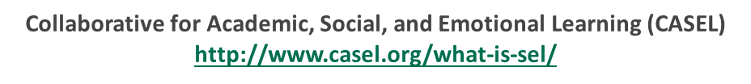
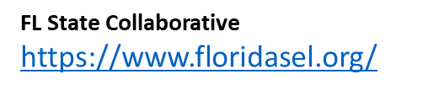
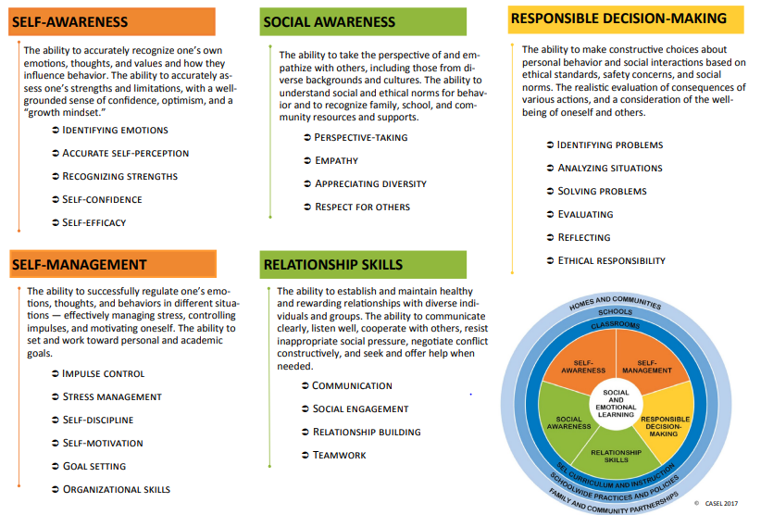
“process through which children and adults acquire and effectively apply the knowledge, attitudes, and skills necessary to understand and manage emotions, set and achieve positive goals, feel and show empathy for others, establish and maintain positive relationships, and make responsible decisions.”
Trauma Informed: use self-regulation replacement skills
http://www.casel.org/wp-content/uploads/2017/08/Sample-Teaching-Activities-to-Support-Core-Competencies-8-20-17.pdf
Notes:
Add link to teaching strategies

Slide 105
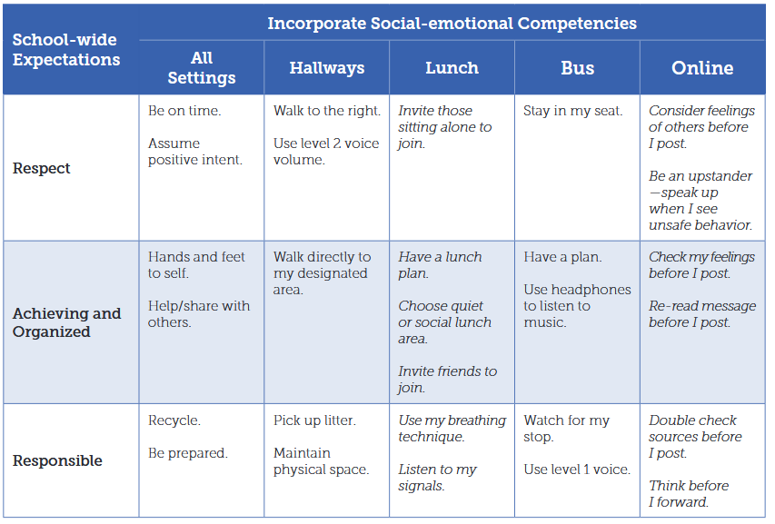
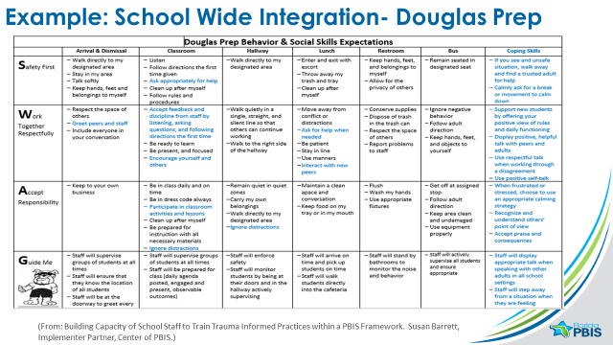
Teaching Social Emotional Competencies Within PBIS Resource and Examples Within A Teaching Matrix https://www.pbis.org/Common/Cms/files/pbisresources/TeachingSocialEmotionalCompetenciesWithinAPBISFramework.pdf
Notes:
Dama- Reference resource
Based on the last slide, here is an example taken from one of our National Technical Assistance Center’s guidance documents that illustrates a School wide Teaching matrix that is created as part of establishing the PBIS framework but also includes some examples of social emotional skills that align with those protective factors mentioned earlier such as friendship skills, conflict resolution and self-regulation skills.

Slide 106
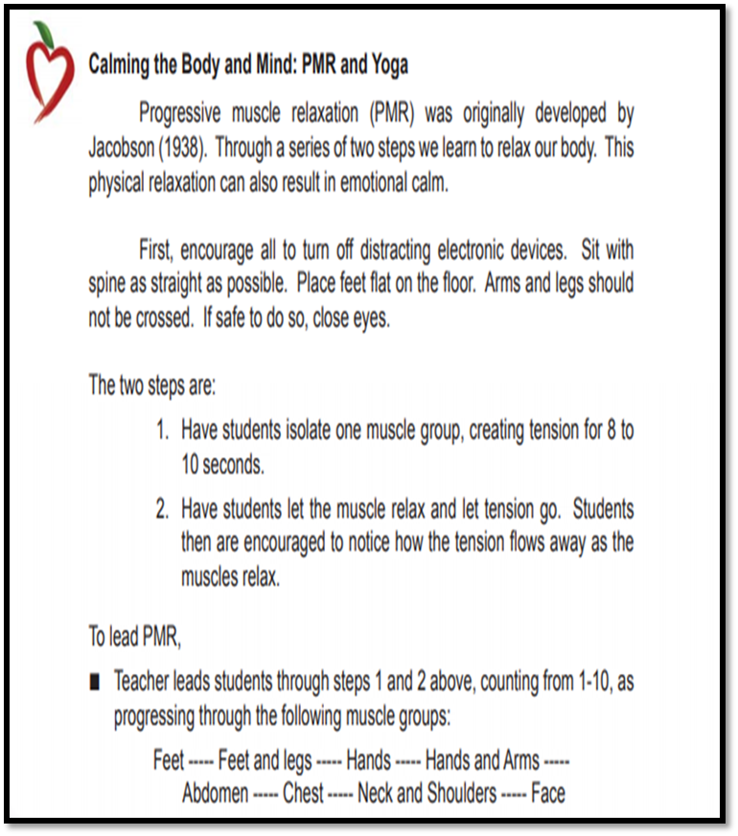


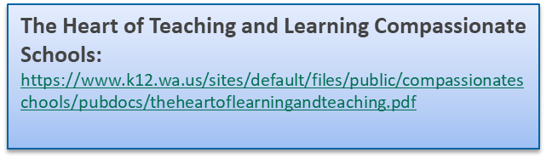
Define & Teach Classroom Routines for Regulation/Self Management And Self Awareness
Routines Expectations
BE SAFE | Think happy thoughts | Draw a picture Ask for a hug | Squeeze a stress ball Take 3 deep breaths Count to 10 | Take 3 deep breaths Count to 10 Go for a walk
BE RESPONSIBLE | Complete my work Remember my goal | Take a mini break Talk to my teacher | Take a break Talk about my feelings | Take a break Talk about the problem
BE RESPECTFUL | Listen to my teacher Help others | Listen to my teacher | Listen to my teacher | Listen to an adult
Notes:
Cat
Rationale: Another concrete example of embedding SW into SEL instruction. In this example, students are taught to associate different colors with different emotional states (red being really frustrated/angry/upset). Teachers taught that even if you feel X, you can still demonstrate being safe, responsible & respectful. Hyperlink is included in “Extend Your Learning” section in back of binder.
Maybe provide a clearer picture of what level I am and strategies to use in routines (looking for examples)
How to identify what Feelings, current state of emotion, and necessary strategies for improvements.

Slide 107
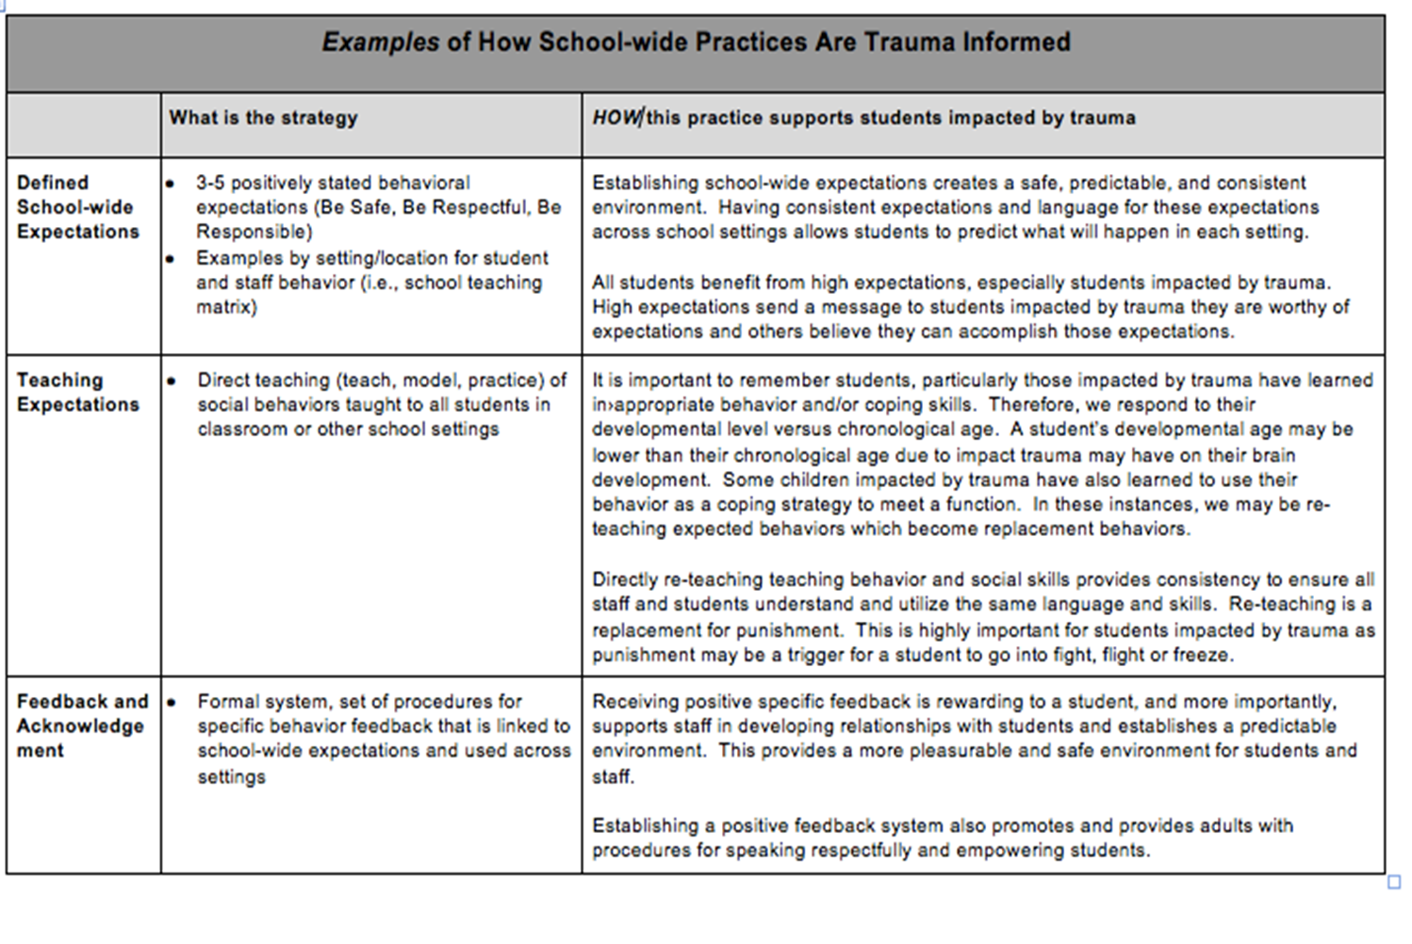
PBIS Prevention MW PBIS Trauma Crosswalk

Slide 108
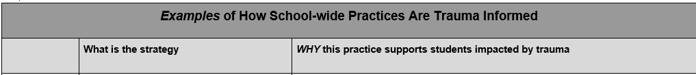
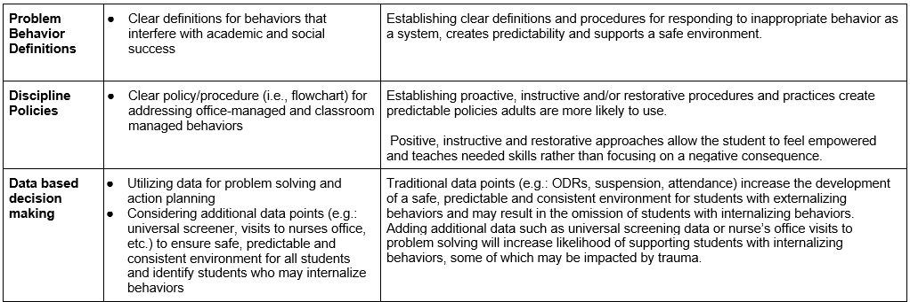
PBIS Promotes Trauma Informed Discipline & Reduction of Risk Factors

Slide 109
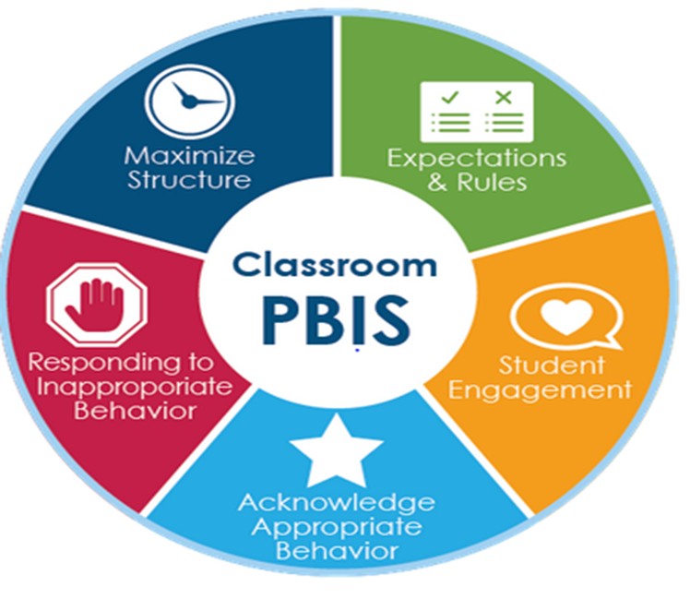
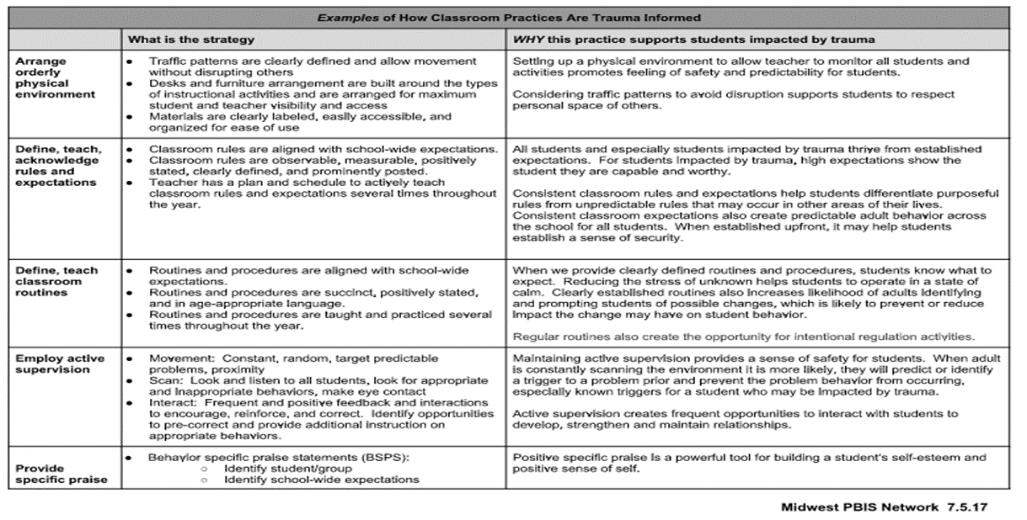
Classroom PBIS Promotes Trauma Informed Classrooms and Promotion of Protective Factors
Classrooms that Integrate PBIS and SEL have the greatest impact in student internalizing concerns
Notes:
Cat Midwest PBIS Network has also created a document to help make the connection of how school-wide PBIS practices are trauma informed.

Slide 110
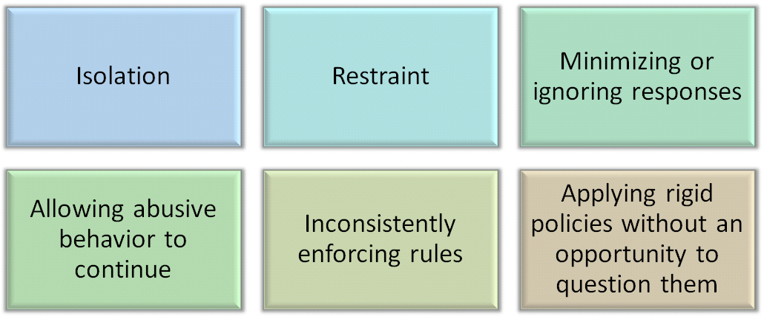
Considering responses that can cause re-traumatization…
Substance Abuse and Mental Health Services Administration. Trauma-Informed Care in Behavioral Health Services. Treatment Improvement Protocol (TIP) Series 57. HHS Publication No. (SMA) 13-4801. Rockville, MD: Substance Abuse and Mental Health Services Administration, 2014.
Notes:
jpg for adobeconnect
Make connection to school practices related to student behavior (seclusion, restraint, dismissing behavior/”boys being boys”, bullying/harassment, inconsistency, lack of student voice).

Slide 111
Use Consistent Procedures
Teacher-Managed (“Minors,” Low Level)
Handled by Administration
Physical fight Property damage Tobacco, drugs
Crisis Incidents
Immediate response by Administration or Crisis Team
Bomb threat Weapon Intruder
Consult district/school policies
Handled by teacher
Quick & efficiently addressed
Handled in class
Tardy Not prepared Incomplete work
Office-Managed (“Majors,” High Level)
Specific “level” definitions can vary by district.
Notes:
Rationale: Having consistent definitions of what constitutes a teacher-managed vs. office-managed event can help to reduce situationally inappropriate behaviors (b/c of consistent expectations). All teachers should have consensus on this, but stakeholders should be involved in the decision making process (we’ll return to this idea in the next section).
A clear distinction must exist between problem behaviors that are teacher/staff managed versus problem behaviors that are office-managed or crisis. This helps with school safety, helps kids who’ve experienced trauma, helps kids who are culturally diverse.
Schools/districts may already use “Level 1, Level 2,” etc.… If this is the case, then need to identify which of the levels are office-managed and which levels are teacher-managed.
Teacher managed: These incidences are still tracked (we will talk about this further in a future part of this discipline procedures section).

Slide 112
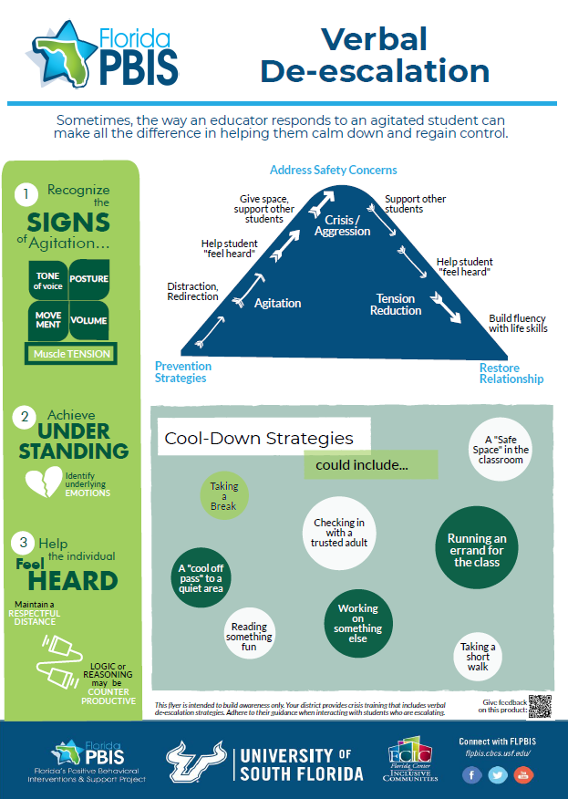
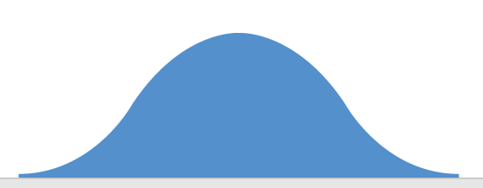
Responding to Behavior Escalations
Address safety concerns
“Safe Space,” cool-off pass, etc.
Give space, support other students
Support other students
Help student “feel heard”
Help student “feel heard”
Distraction, Redirection
Build fluency with life skills
Prevention Strategies
Restore relationship
Notes:
Make this a handout too; get input if awareness-level information of verbal de-escalation is appropriate for our training. We will always direct to CPI for formal training.
Activity – align prevention & responding strategies to the continuum

Slide 113
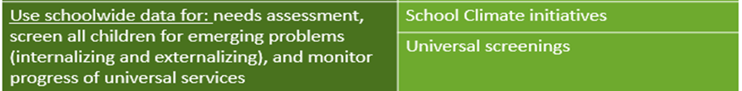

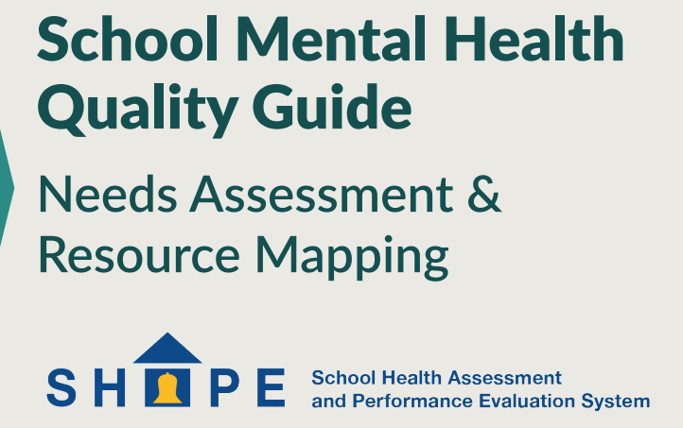
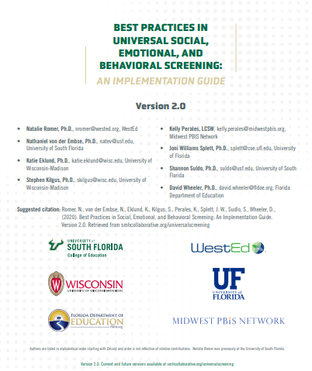
Resources for Tier 1 MH Promotion Within PBIS
http://www.schoolmentalhealth.org/media/SOM/Microsites/NCSMH/Documents/Quality-Guides/Needs-Assessment-&-Resource-Mapping-2.3.20.pdf
https://smhcollaborative.org/wp-content/uploads/2019/11/universalscreening.pdf
https://www.livebinders.com/media/get/MjAyNDUzMzA=

Slide 114

Integrated Systems Framework (ISF):
PBIS provides structure and foundation for scaling up a broad range of evidence-based mental health interventions within schools and communities
School Mental Health
ISF
MTSS/PBIS
(Barrett, Eber, & Weist, 2013)
https://www.pbis.org/school/school-mental-health/interconnected-systems
http://www.midwestpbis.org/interconnected-systems-framework/tools

Slide 115
Targeted Intervention Examples (Tier 2)
Features | Example
Focus: Minimize risk for students with specific needs, based on experiencing a risk factor (e.g., trauma, loss, family disruption) or demonstrating elevated social-emotional-behavioral symptoms | Anxiety: Coping Cat; MATCH-ADTC
 | Depression: Taking ACTION; Coping with Stress (CWD-A); MATCH-ADTC; IPT-A;
Use group and individual data to: identify specific needs and monitor progress | Anger: Anger Coping Program; Coping Power Program; Think First; BEP: Check in Check Out
Development and generalization of skills in a specific need area (e.g., anxiety, depression, grief, peer relations) | Aggression and noncompliance: Behavioral parent training; First Steps to Success
Opportunities to practice skills aligned with goals to reduce risk | Family disruption (divorce): Children of Divorce Intervention Program
Via small group or individual attention, provide direction instruction modeling of skills taught | Provide a student drop-in center staffed by SMH provider, to assist at-risk students
- Christner & Mennuti, 2009; Simon, 2016
Notes:
CR
Early intervention activities ; appropriate for students with ongoing need but whose level of need is not significant enough to warrant more intense and individualized treatment (e.g., appropriate for a limited number of students who continue to demonstrate minor anger or aggressive behavior, resistant to the school’s universal bullying prevention/reduction program)
Appropriate for students who have experienced specific life stressors (grief, divorce, child maltreatment, physical health problems

Slide 116
Ensure Interventions Focus on Internalizing Symptom and SE wellness skills
Daily Progress Report (DPR) Sample MW PBIS
NAME:______________________ DATE:__________________
Teachers please indicate YES (2), SO-SO (1), or NO (0) regarding the student’s achievement
in relation to the following sets of expectations/behaviors.
Trauma-Informed
Tier 2 Group
EXPECTATIONS | 1 st block | 2 nd block | 3 rd block | 4 th block
Be Safe | 2 1 0 | 2 1 0 | 2 1 0 | 2 1 0
Be Respectful | 2 1 0 | 2 1 0 | 2 1 0 | 2 1 0
Be Responsible | 2 1 0 | 2 1 0 | 2 1 0 | 2 1 0
Total Points
Teacher Initials
Self-Check
Use calming strategy
Use your words
Use safe hands
Ask for help
Connect with safe person
Adapted from Grant Middle School STAR CLUB
Adapted from Responding to Problem Behavior in Schools: The Behavior Education Program by Crone, Horner, and Hawken
Notes:
116
NR
Example of progress monitoring tool that includes internalizing skills that may be the focus on Cognitive behavioral tier 2 supports for Trauma such as the CBITs, or Coping Cat programs. Traditionally a DPR may only be used on a campus for externalizing behaviors.

Slide 117
Intensive Intervention Examples (Tier 3)
Features | Example
Focus: Direct, ongoing interventions based on the individualized need of a student | Functional Behavior Assessment => Behavior Intervention Plan
Use individual-level data to: conceptualize student’s needs, create goals, and monitor progress | Check and Connect for student at-risk for dropout
Create a treatment plan consisting of intervention modalities matched to the student’s individual needs and goals | Individual therapy from a theoretical framework (e.g., CBT, client-centered, interpersonal, etc.)
Opportunities to practice skills aligned with therapeutic goals (goal: keep stable an emotionally fragile student) | Family-focused intervention (e.g., Multi-Systemic Therapy; Family Check-Up => Family Treatment Plan)
Offer individual or small group therapy to foster growth and improve functioning (via skill development; also motivation to change) | Referral to, and consultation with, community-based resources
Interagency Agreements and Partnering
Considering district partnering with agencies through MOUS for services/supports?
Role of agency and district staff
Information sharing
Communication with families and school teams
Legal considerations
http://www.midwestpbis.org/interconnected-systems-framework/examples
- Christner & Mennuti, 2009
Notes:
CR
Christner & Mennuti only list therapy options in the right columns (different orientations for therapy)
Goal of intensive services: Decrease level of impairment associated with an existing emotional/behavioral disorder and enhance a student’s level of functioning and ability to learn.
Interventions can sometimes be provided in a small group setting, but are more often individual
Interventions are highly individualized based on student’s needs, and selected based on assessment and case conceptualization
Therapeutic goals: not to focus exclusively on skill building via psychoeducational activities (common focus of Tier 2), as the goals further include symptom reduction, increase coping skills, and exploration of factors that prohibited adequate skill acquisition

Slide 118


Key Questions &
Infrastructure
At ALL tiers
KNOW…
Who is receiving services.
School-based? Community?
←Decision Rules for Moving In/Out of Tiers→
Is Your SYSTEM Working? (identifying students, PD)
What services are being delivered.
Evidence-based? With fidelity?
If it is working!
Are students having positive outcomes as a result of the services being received?
Notes:
NR
The data you collect, the tools you use, and the interventions that are needed may vary depending upon the levels of need (tiers of support) and the types of need (social skills verses emotional support). However, the basic questions and elements of infrastructure are consistent in the MTSS for mental health model. Considering Supports within and outside the school as part of this continuum.

Slide 119
Resources
FLPBIS Mental Well Being Live Binder For Teams: https://www.livebinders.com/play/play?id=2641613
Skill Development Modules On Integrating SEL and Trauma Informed Practices Into PBIS Framework: https://www.livebinders.com/play/play?id=2646204

Slide 120




Contact Information and Resources
FLPBIS:MTSS Project
  Phone: (813) 974-6440
  Fax: (813) 974-6115
  E-mail: flpbis@cbcs.usf.edu
  Website: www.flpbis.org
OSEP TA Center on PBIS
  www.pbis.org
Association on PBIS
  www.apbs.org
www.facebook.com/flpbis
www.twitter.com/flpbis
https://www.youtube.com/user/flpbs1
Notes:
May want to share a video here of Rita Pierson’s TED Talk as a wrap up

Slide 121
Q & A with Discussion

Slide 122
Thank you
for attending.

